Slide 1
Paludiculture UK
Working with our wetlands
29th-30th November 2017

Slide 2
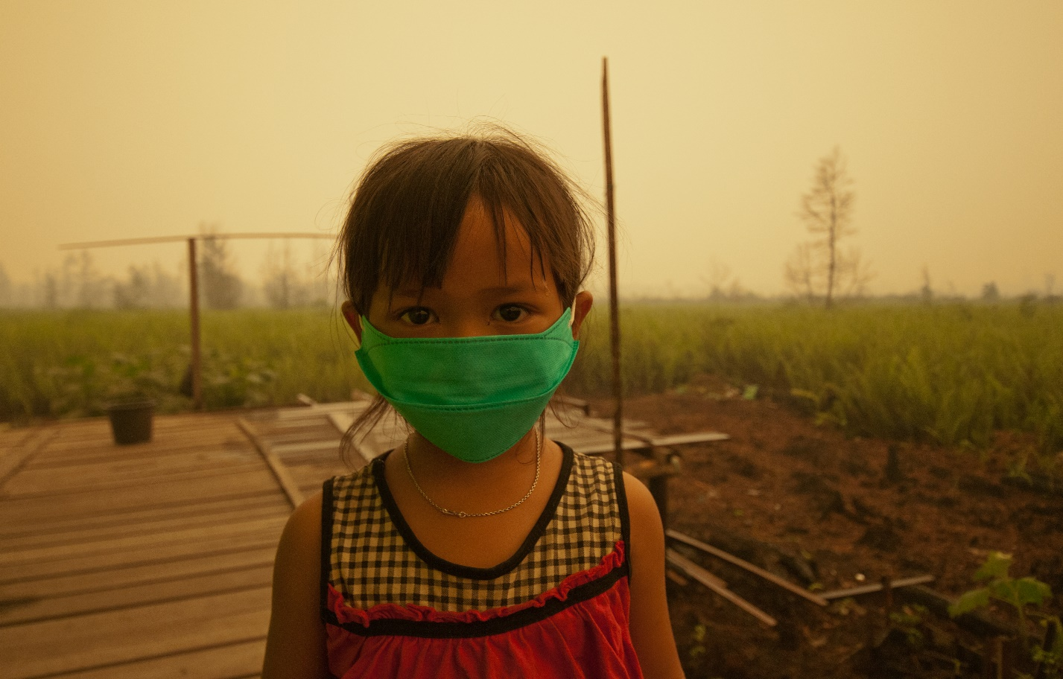
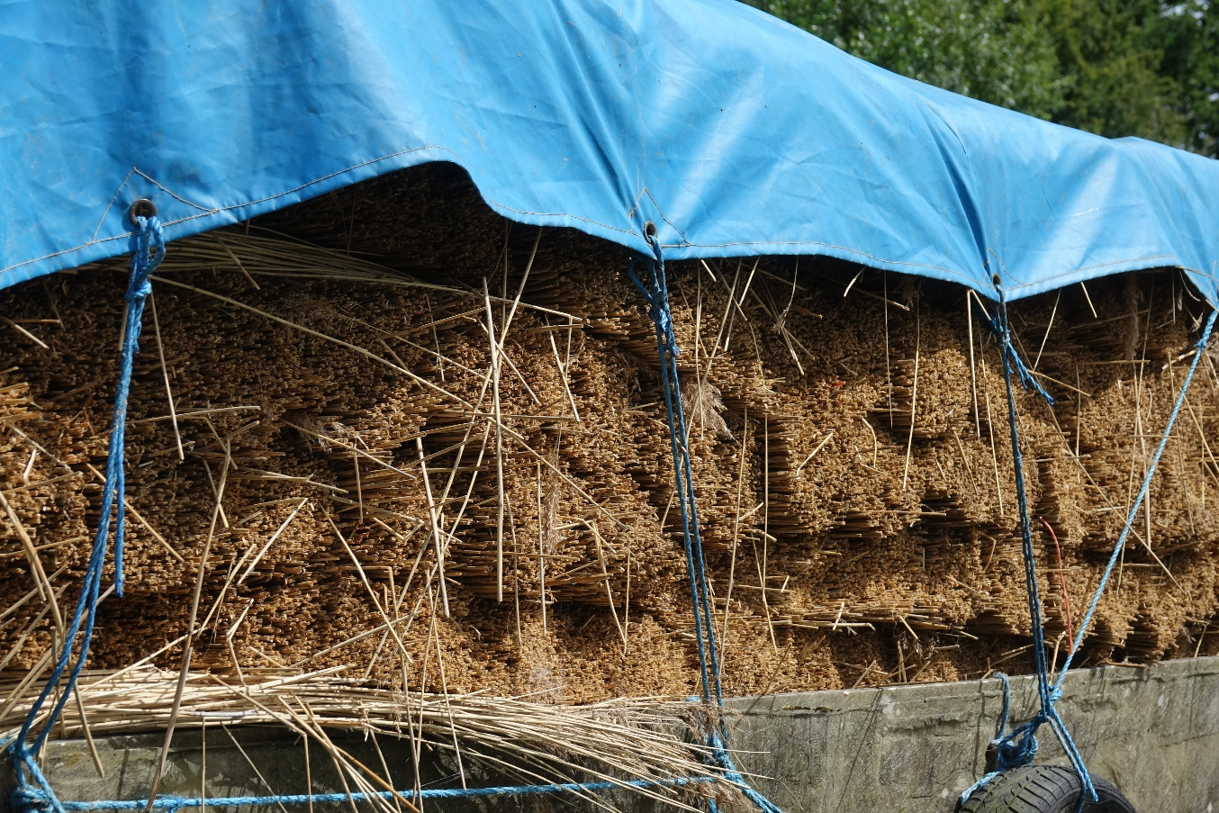
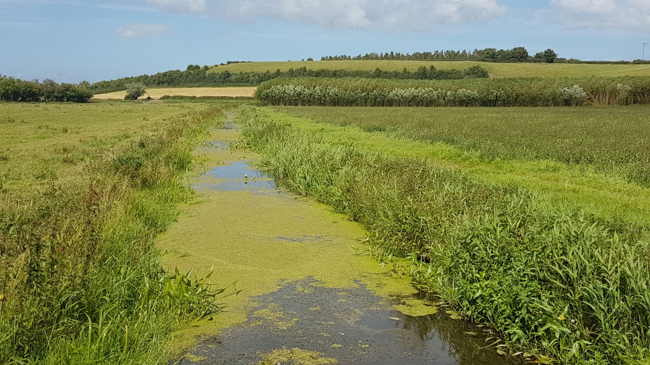
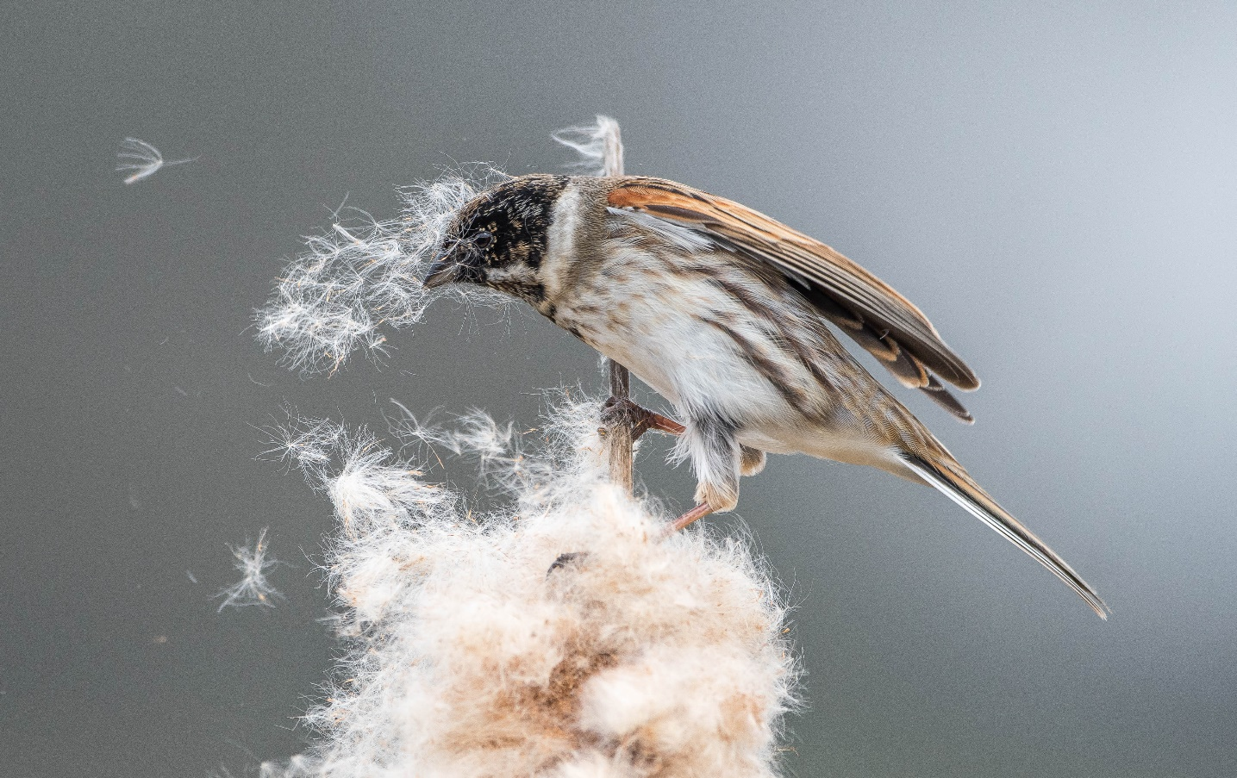
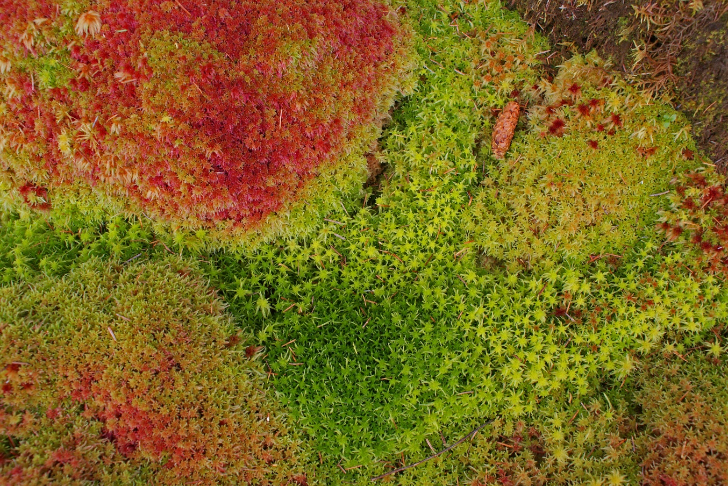
© Trevor WIlson
© Ahmad Aquel
© Aulia Erlangga CIFOR
Notes:
Global importance of wetland systems, especially peatlands for water, biodiversity, carbon storage, fibre and fuel.
Unsustainable use of these systems places the habitats, and the cultural services they provide, at risk. The negative effects of drainage based land use we are all aware of, including habitat loss, carbon emissions and fire and haze (SE Asia)

Slide 3
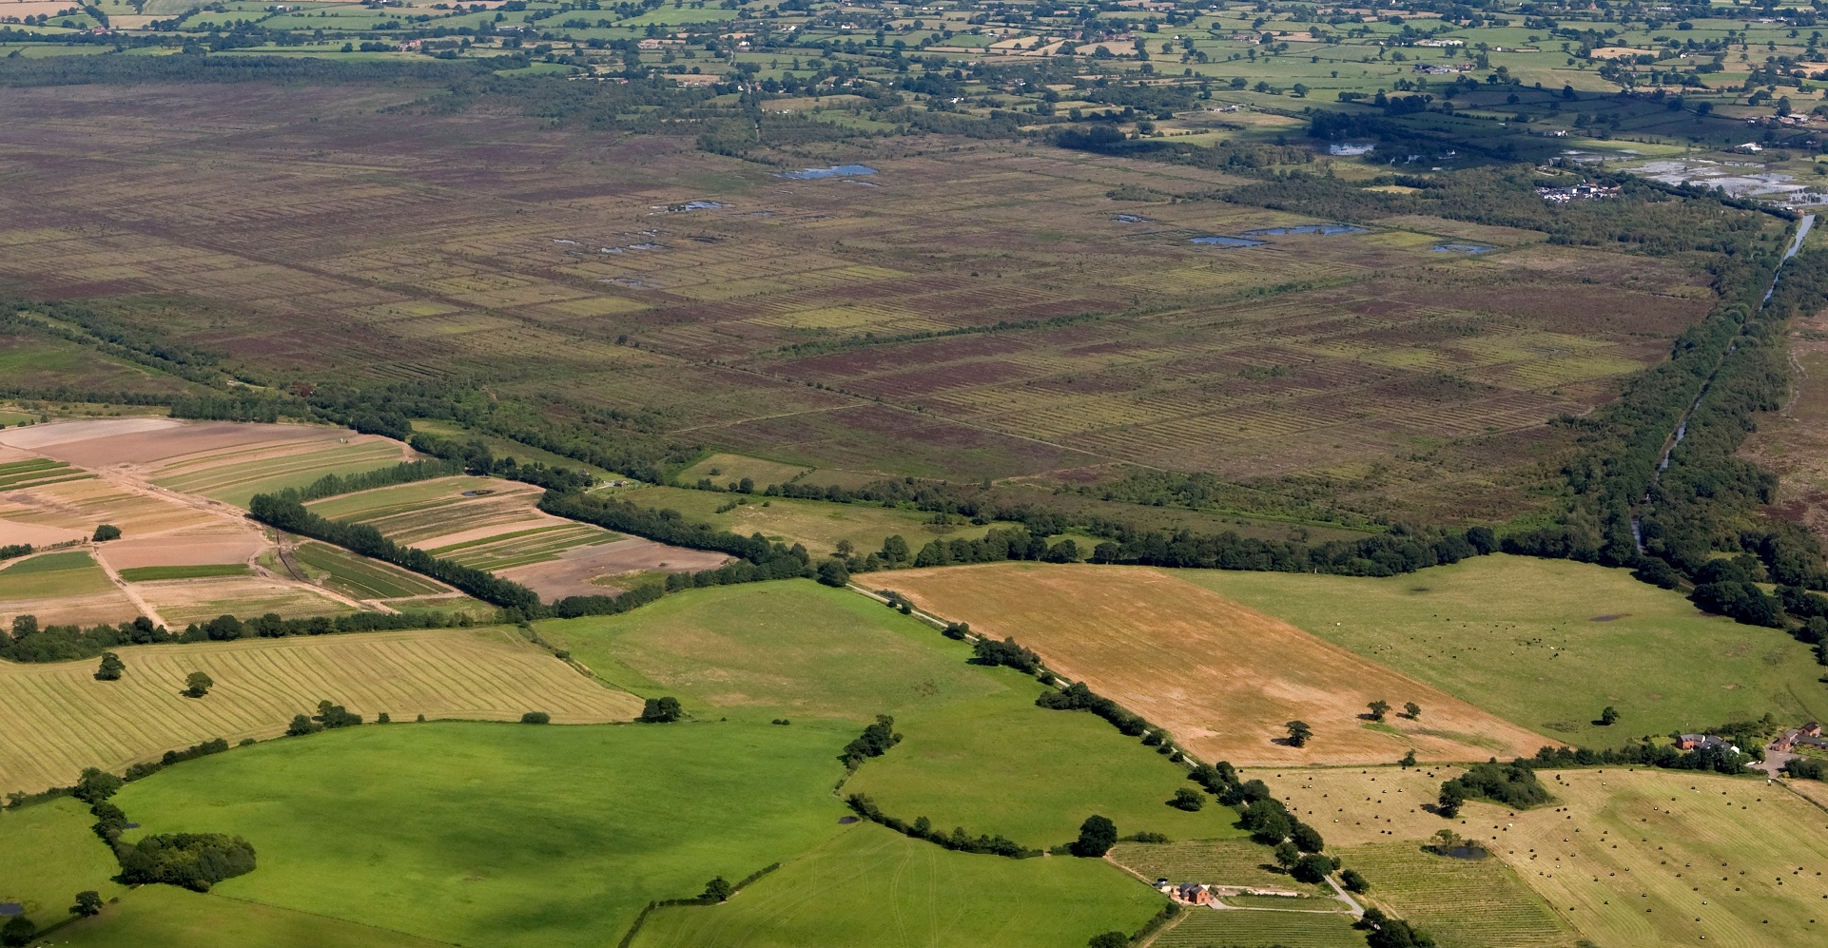
© Marches Mosses Shropshire Wildlife Trust
Notes:
A shift towards more sustainable ways of managing the land is on the horizon. Thanks to growing policy support and a recognition for conserving peatlands, we are already achieving this in some of our upland systems. Through large scale peatland restoration schemes and land which continues to be used for agricultural use, such as the grazing of hill sheep.
However, changes in land management practices in many lowland settings are still a barrier. Being able to demonstrate that there can be some economic return in some peatlands will be key to bringing about some of these changes in land management. However, wetland farming or paludiculture is not a panacea and will not be the answer in all cases.

Slide 4
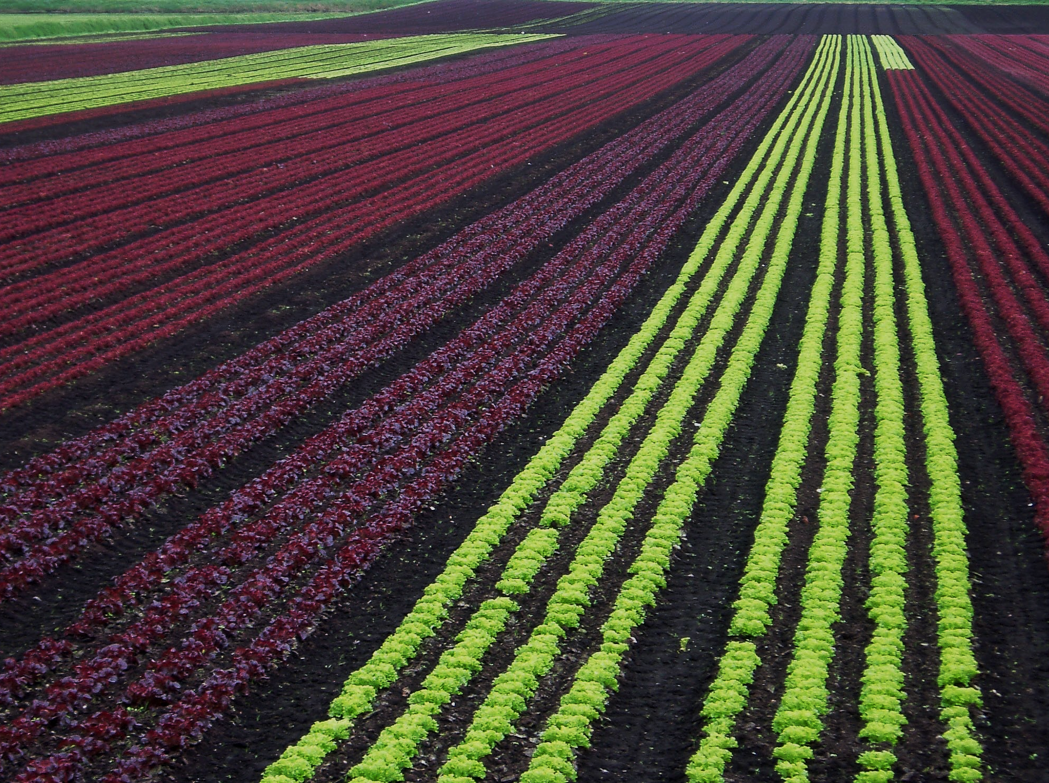
UK Peatland Strategy
Adapt management of drained peatlands under intensive productive use”
1. Reduce the impact of greenhouse gas emissions
2.Maintain the distribution and extent of agricultural peat soils across the UK
Notes:
The UK Peatland Strategy, which will be published in January sets out a goal for ‘Adapting the management of drained peatlands under intensive productive use’
With the outcomes being to:
1. Reduce the impact of greenhouse gas emissions from the agricultural use of peat through a shift to more sustainable management.
2.The distribution and extent of agricultural peat soils across the UK is maintained, through the introduction of new soil management regimes and cropping systems.

Slide 5
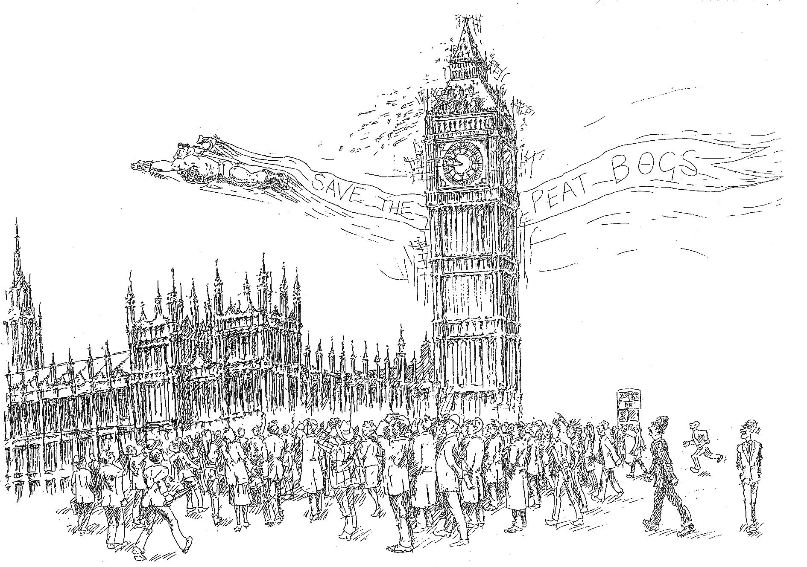
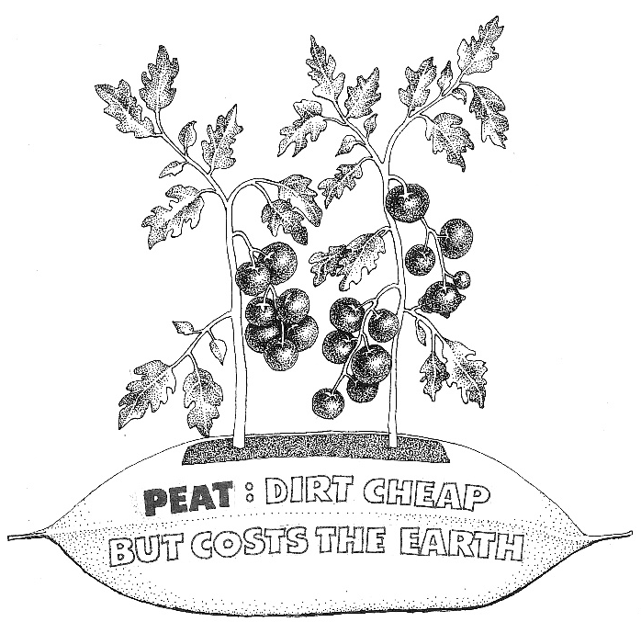
Notes:
Time for a transition. The opportunity presented to us through the desire of the horticultural industry to embrace more sustainable practices is one which we should seize. There will be other examples in the UK where individuals are ready to support change and it is our responsibility to make sure that paludiculture is not just a vision within the UK. We need to be able to start and deliver actual projects and large scale demonstration sites. There are obvious challenges associated with this which need to be overcome quickly- funding being an obvious initial barrier to delivering these projects.
Paludiculture represents an opportunity to convey peatlands as ‘useful’ and ‘valuable’ to new audiences and so communication will be a vital part of any projects going forwards. There are opportunities with a range of peatland products to do this e.g. cranberries for the Christmas dining table originate from peatlands. Sphagnum has historic and cultural value- the story of Sphagnum being used in wartime wound dressings always seems to capture the public imagination and interest- but there are also modern day uses as a gardening product in the form of ‘white peat’.

Slide 6
Workshop questions:
What is paludiculture?
Where and when could it be necessary in the UK?
What are the challenges, incentives and opportunities?
Who are the key partners?
What is the market potential?
Can it be a viable, sustainable alternative to more traditional agriculture on wetlands?
Notes:
As you will see from your delegate pack, there are a range of questions which we hope to explore:
What is paludiculture?
Where and when could it be necessary in the UK?
What are the challenges, incentives and opportunities?
Who are the key partners?
What is the market potential?
Can it be a viable, sustainable alternative to more traditional agriculture on wetlands?
I, and I am sure the rest of you as well, are looking forwards to discussing many of these aspects over the next two days as we hear from a range of speakers and have the chance to exchange ideas about how the future of paludiculture in the UK can be shaped.
Our keynote speakers this morning will be presenting on their experiences from across Europe:
Greta Gaudig will cover the potential for climate change adaptation and mitigation from paludiculture
Sabine Wichmann will share with us some experience of production of crops on peatlands in Germany
And Silke Kumar will finish off this mornings first session with a presentation on the production of Sphagnum as a horticultural product.
Thank you and enjoy the conference.

