Slide 1
Paludicultures, in Cumbria?
Jack Clough, Research Assistant and Paludiculture PhD student

Slide 2
Introduction
Where are the best locations for paludicultures in Cumbria – with reference to designated sites?
Which crops could be grown?
What are the potential markets?

Slide 3
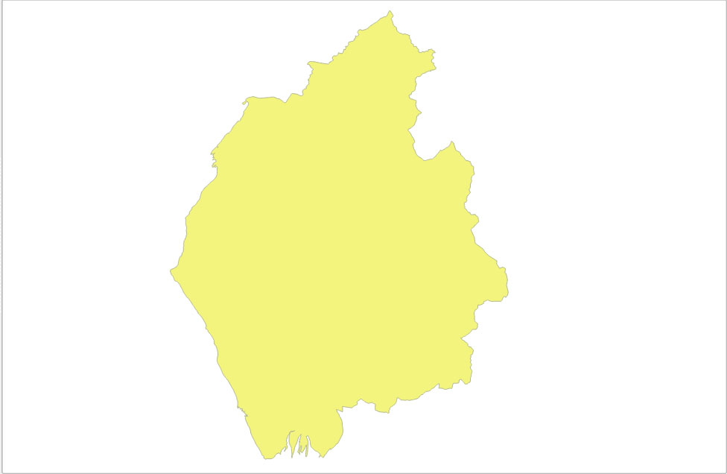
681,685 ha in Cumbria

Slide 4
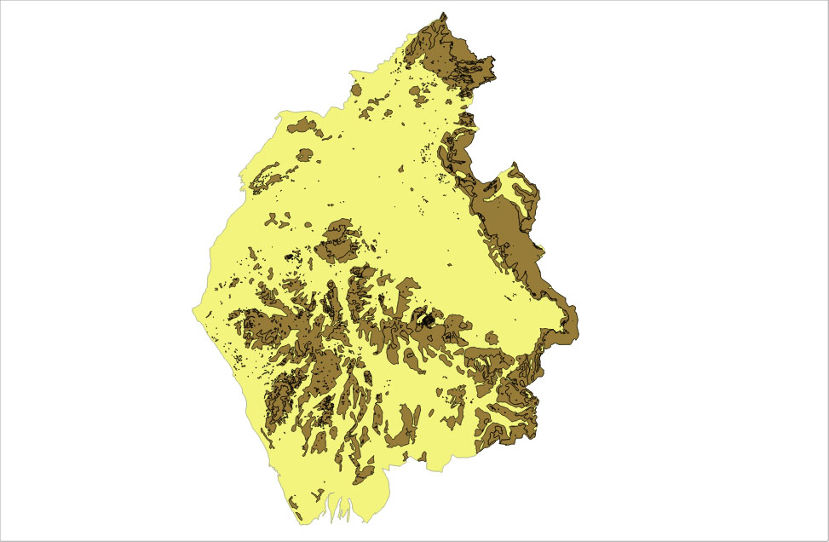
217,000ha of peaty soils

Slide 5
53 lowland peatland SSSI’s

Slide 6
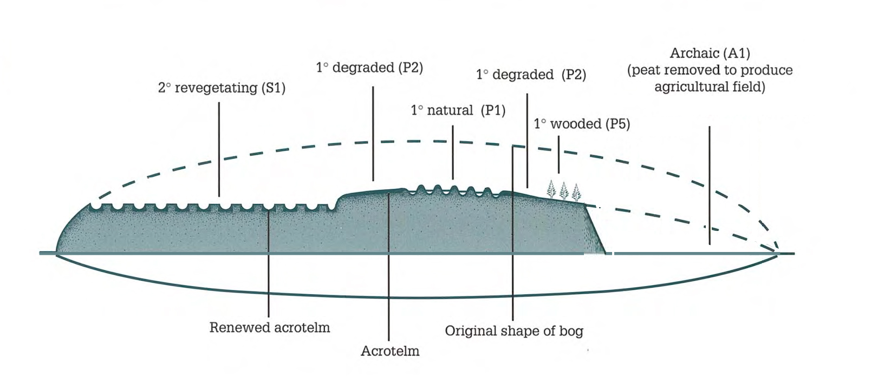

Slide 7
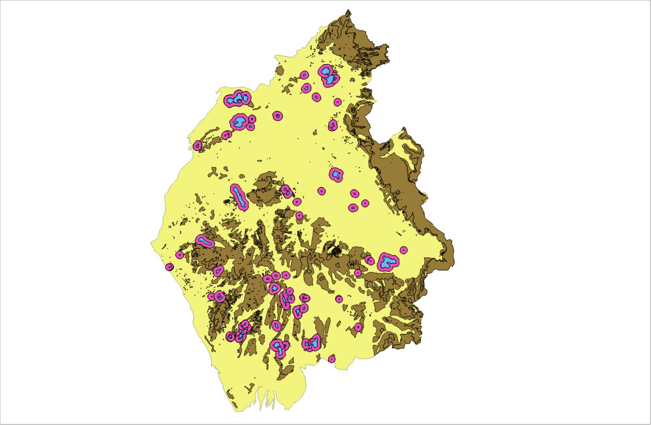

Slide 8
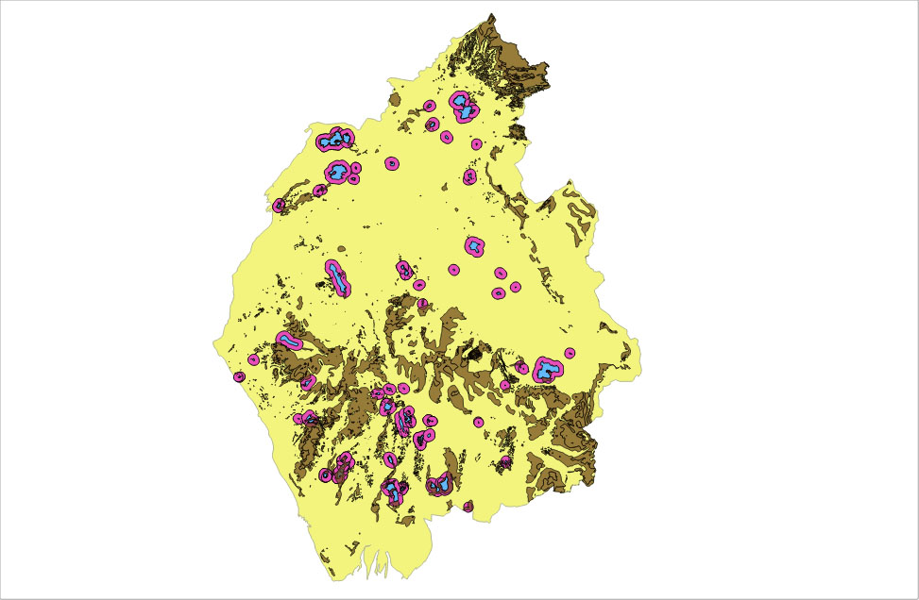

Slide 9
Cumbria wide map – approximately 5000ha of peaty soils are on slopes of 2 degrees or less within the 1km SSSI buffer zones. Which could be protected with paludicultures.
Approximately 108,000 ha of peaty soil exists on slopes of 2 degrees or less outside of protected areas and the suggested buffers.
– These are mostly on existing farmland, which could be converted into paludicultures

Slide 10
Scoring and Evaluating Case study areas
SSSI buffer - Paludiculture Potential Questions | Score
Is there unprotected peat within the SSSI buffer? | 1
Is the peat within the buffer well connected? | 1
Does at least some of the unprotected peat connect with the SSSI | 1
Does the buffer area contain over 10% peaty soils, with a slope angle of 2 degrees or less? | 2
Does the buffer area intersect with an EA flood risk zone? | 2
Is the majority of the buffer area on land with an ALC of 4 and 5? | 2
Is the majority of the buffer area on land with an ALC of 2 and 3? | 1
total score (Max 9)

Slide 11
Sunbiggin Tarn & Moors and Little Asby Scar
Outley Mosses

Slide 12
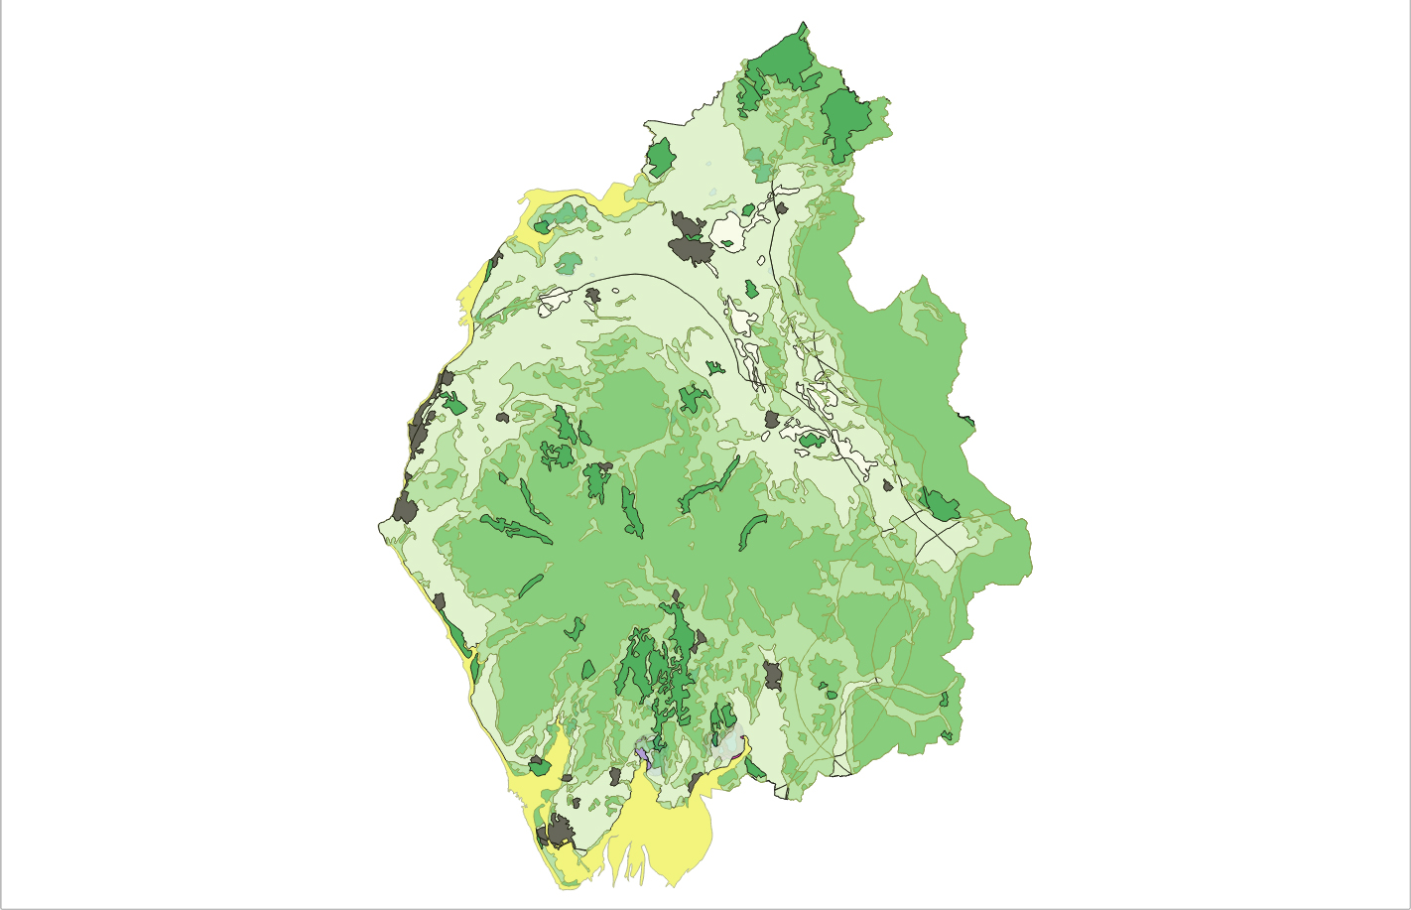
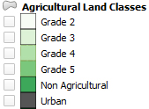

Slide 13
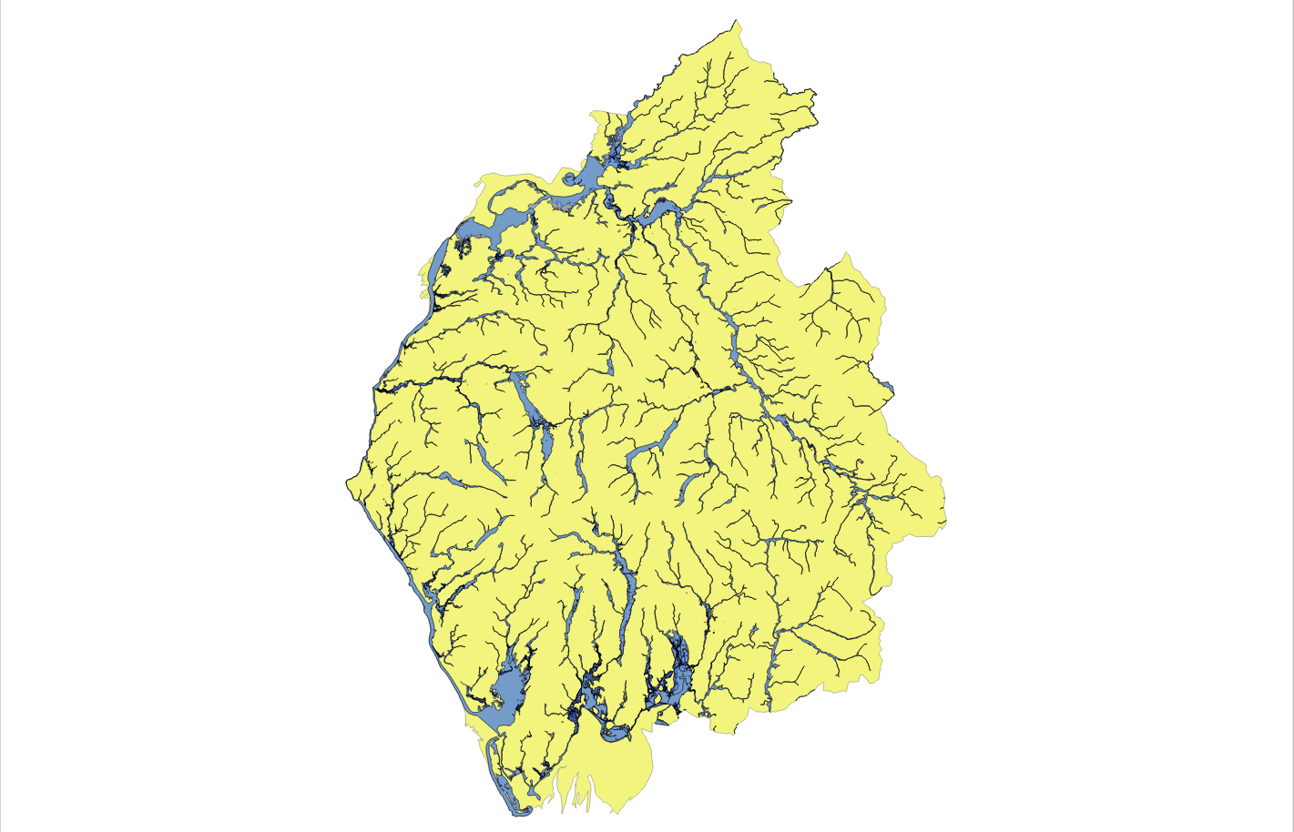

Slide 14
Paludiculture Potential for Lowland SSSI sites

Slide 15
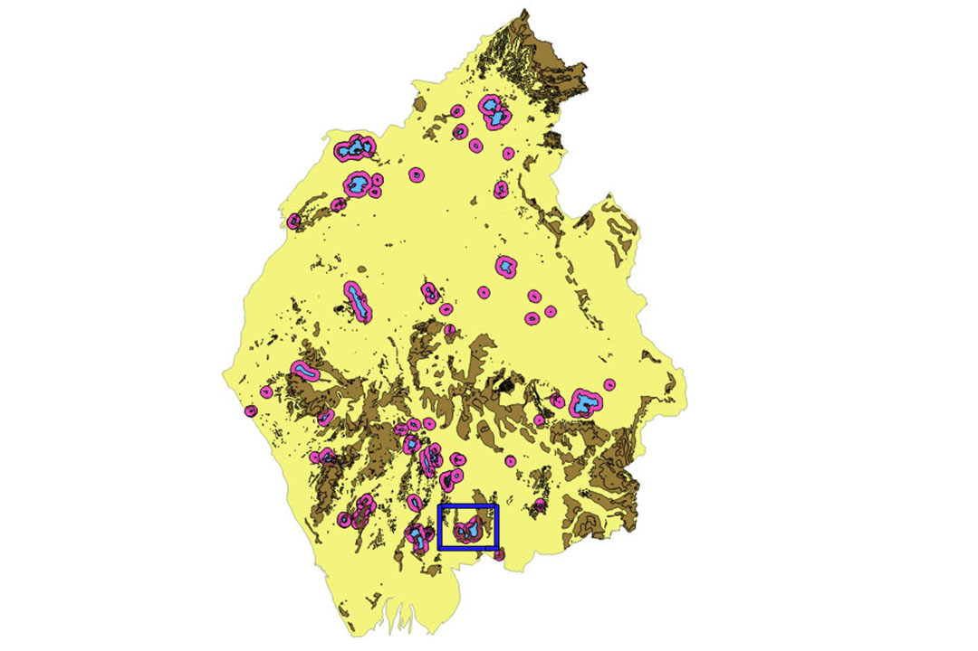
Case study: Nichols Moss, Meathop
and Foulshaw moss

Slide 16
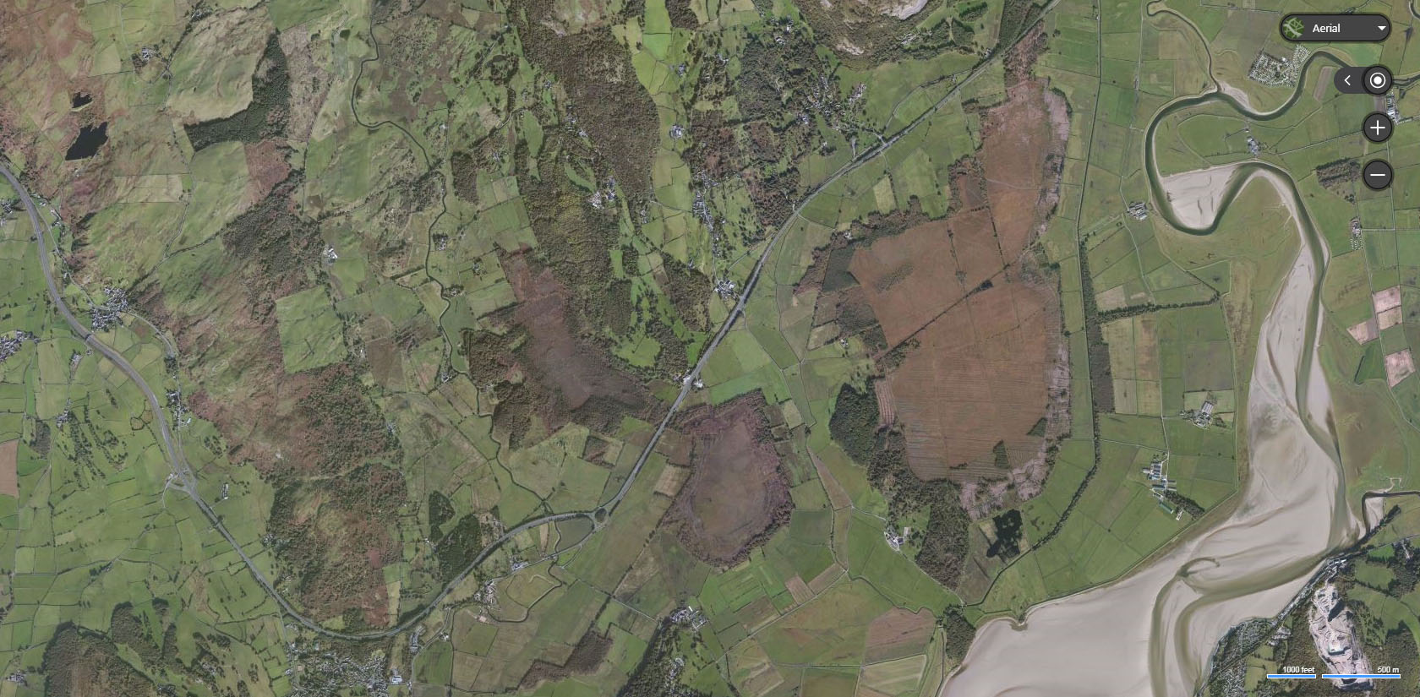
Case study: Nichols Moss, Meathop and Foulshaw moss

Slide 17
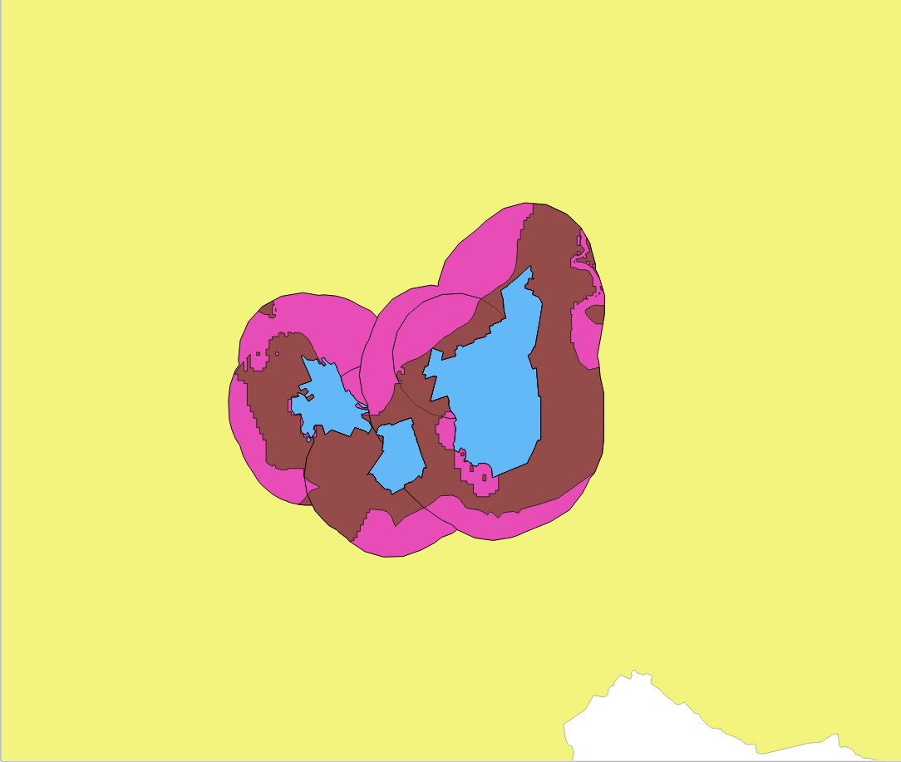
Case study: Nichols Moss, Meathop and Foulshaw moss

Slide 18
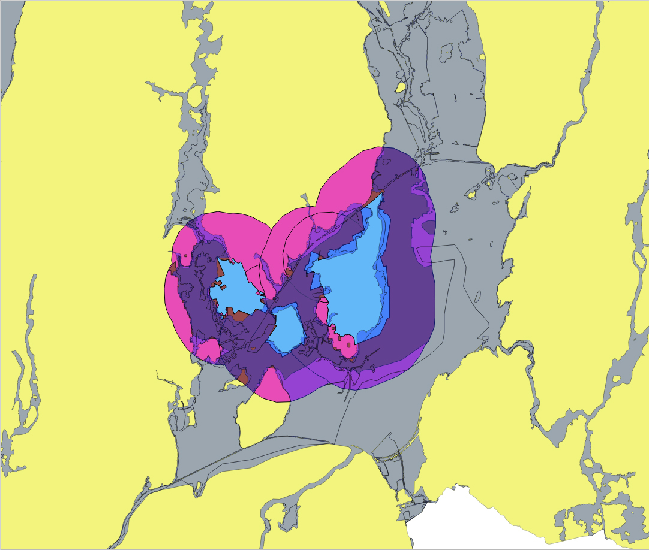
Case study: Nichols Moss, Meathop and Foulshaw moss

Slide 19
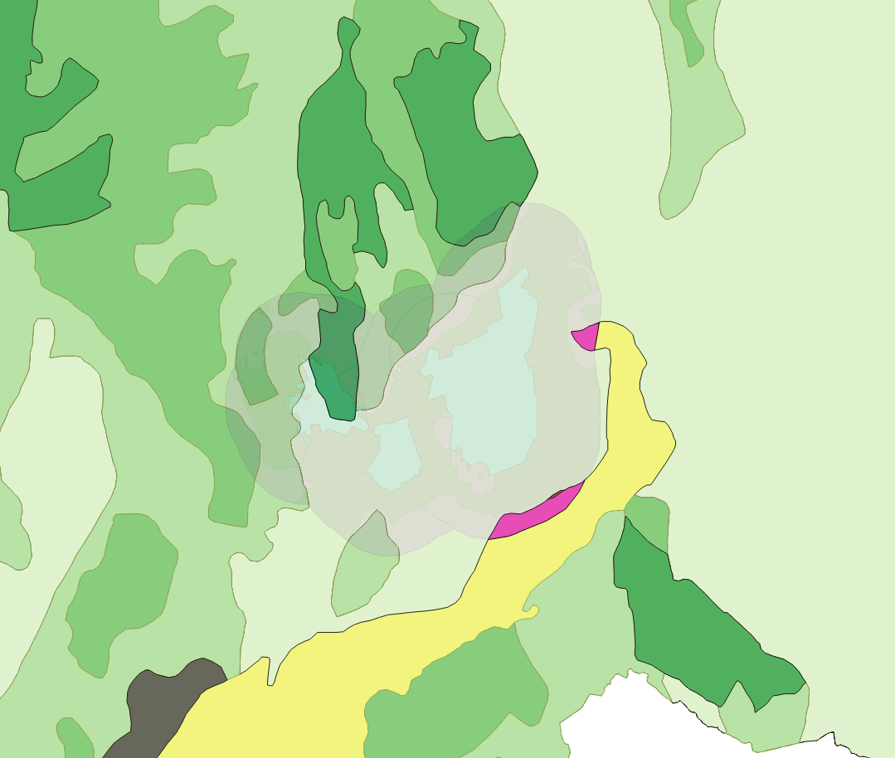
Case study: Nichols Moss, Meathop and Foulshaw moss

Slide 20
What are the products and markets?
DPPP: over 3000 sp
333 have very good potential
75 suitable species

Slide 21
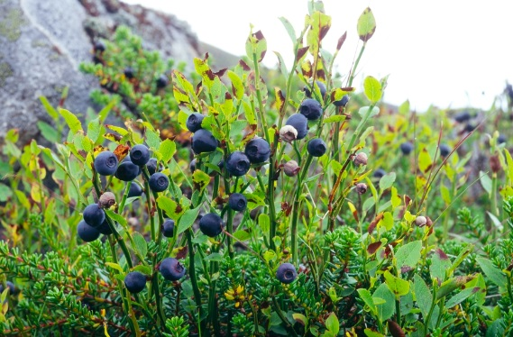
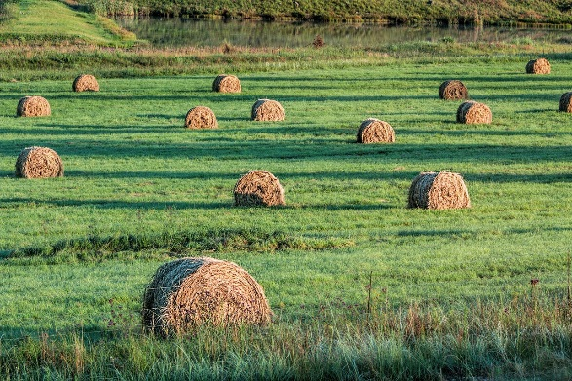
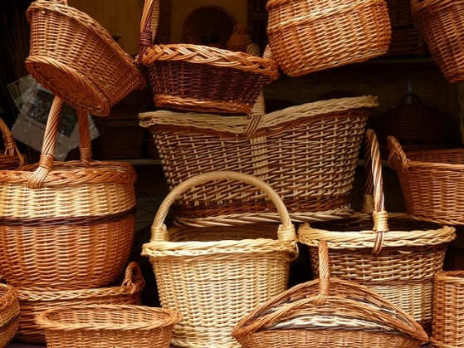
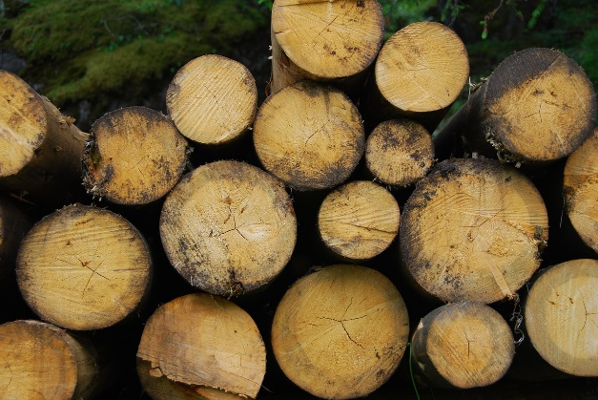
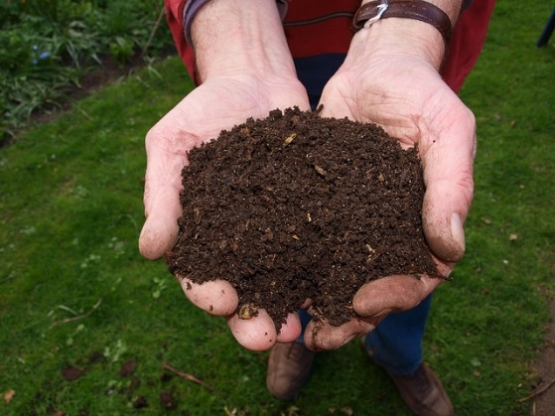
What are the products and markets?
Food
Fodder
Medicines & supplements
Ornamental/ raw materials
Biomass/ energy
Agricultural conditioners

Slide 22
What are the next steps?
Develop the UK DPPP further;
Provide opportunities and resources to local farmers;
Trial different systems for different crops;
Develop and adapt existing farming equipment to cope with harvesting on wet soil;
Develop and build additional markets;
Investigate the potential for ‘carbon’ farming credits to further increase profitability.

Slide 23
Images produced using ArcGIS and QGIS:
Summary of GIS layers used:
Peaty Soils Locations (source: NE, BGS, NSRI and OS)
SSSI Locations (source: data.gov.uk under open government licence).
Cumbria County Administrative boundary (source: data.gov.uk under open government licence).
Agricultural Land Classifications (source: data.gov.uk under open government licence).
Environment Agency Flood Risk Zones 2 and 3 (source: data.gov.uk under open government licence).
Additional images:
Taken from Pixabay.com under the creative commons licence, no attribution needed.

