Slide 1
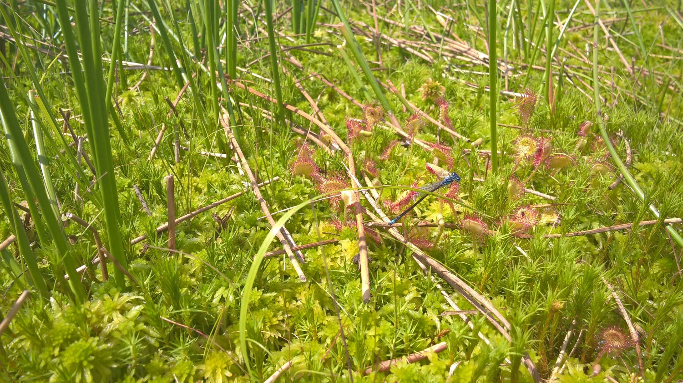

Sphagnum farming as paludiculture on bogs for replacing peat in horticulture
Experiences in Northwestern Germany

Slide 2
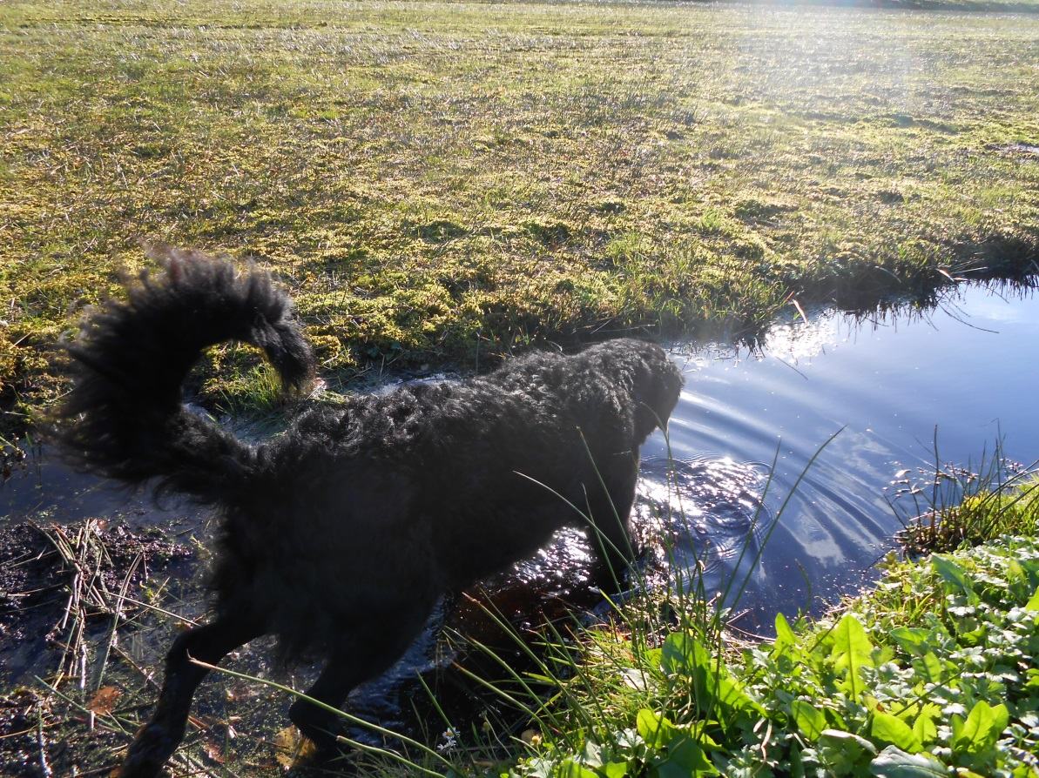
Contents
Introduction
Motivation
Area
Activities
Results
Foto: MoKuRa

Slide 3
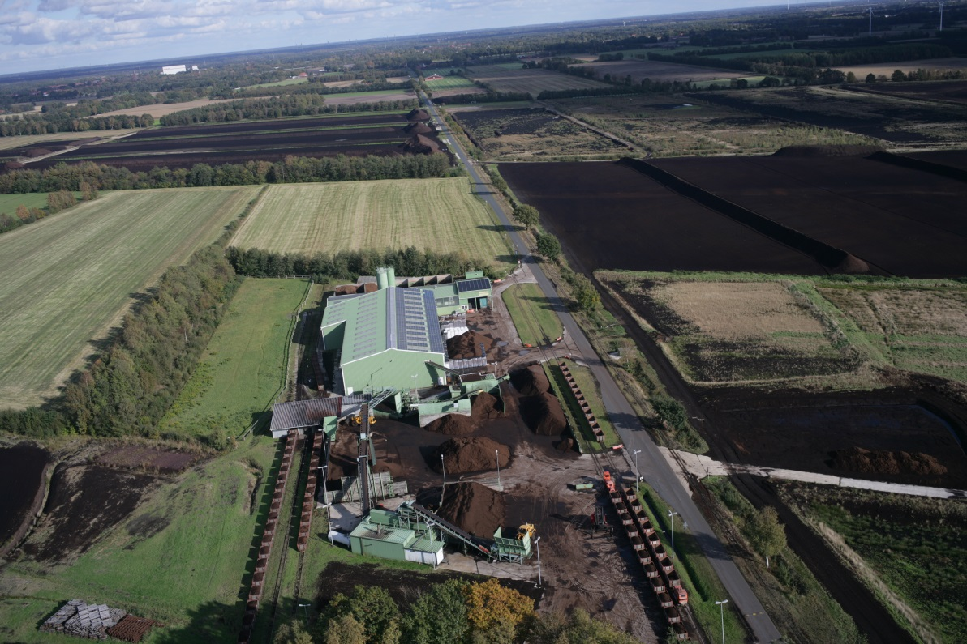
Introduction: the company
History
Founded around 1910 as agricultural enterprise
Peat extraction since1924
family owned since 1959
Today
350.000 cbm peat as raw material for growing media
80.000 cbm growing media for professional hort.
550 ha extraction area
ca. 1100 ha rewetted area
40 fte (full time employee equivalents)
3 apprentices
6 Mio Euro turnover per year
Certifications
ISO 9001:2015
RAL certification for growing media
RHP certifcation for peat
RPP Responsibly produced peat certification
Foto: MoKuRa

Slide 4
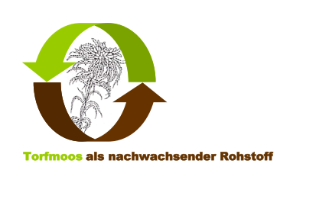




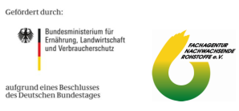

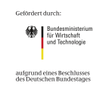


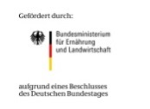



Introduction: Paludiculture Projects
2007 - 2010
Trial Field Ramsloh:
on cut-over bog
2004 - 2007
Tests with Floating mats
Moosfarm
2010 – 2013
2011 - 2015
2011-2015
2010 - 2014
Trial field Hankhausen:
on former bog grassland
SPHAKO 2015 – 2018
Production of Sphagnum based GM for professional horticulture
Sphagnum Moss from Ramsloh, Finnland, Hankhausen
since
2015

Slide 5

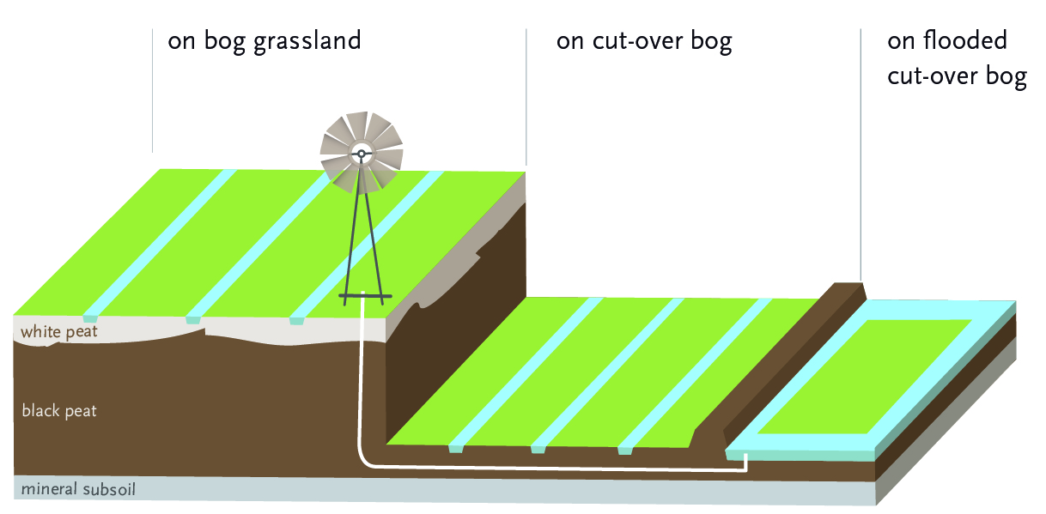
Mosaic of different Sphagnum farming types
on degraded bogs
Notes:
neu

Slide 6

Introduction: Project partners:
Carl-von-Ossietzky-University Oldenburg
Dr. Dittrich & Partner Hydroconsult GmbH Dresden
Ernst Moritz Arndt University Greifswald
Graalfs Horticulture Aurich
Humboldt University Berlin
IASP Berlin
Klasmann Deilmann, Groß-Hesepe
Agency for Soil, Mining and Geology of Lower Saxony, Bremen
LVG Ahlem
LVG Bad Zwischenahn, both Chamber of Agriculture of Lower Saxony
MST Drainage tools GmbH Twistringen
NIRA Groß Ippener
Rosengut Langerwisch
Textile Research Institute of Saxony, Chemnitz
Tree Nursery Scheper, Saterland
University Rostock
University of Applied Sciences Weihenstephan – Triesdorf
Notes:
Emphasize a special one Klick

Slide 7
Motivation
Insuring the future of the company because of difficulties in getting new extraction permits
Drive towards peat reduced potting mixes
Finding new land-use options for drained bog grasslands to reduce GHG emissions
Improving restoration techniques

Slide 8
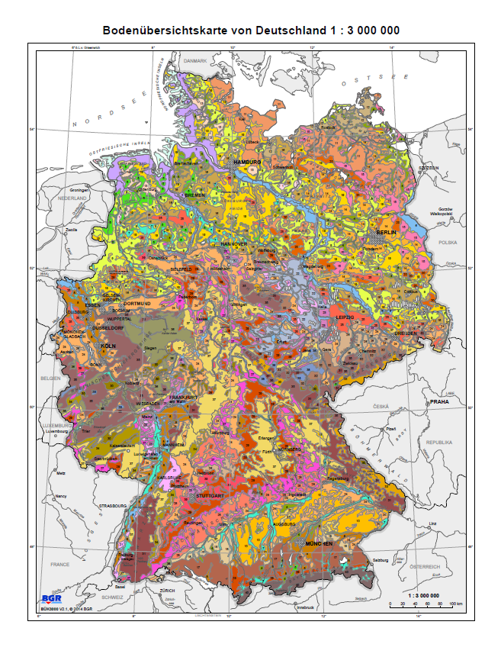
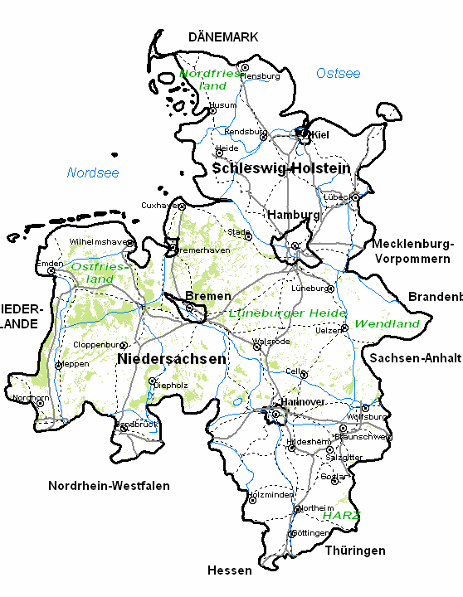
Area: Northwestern Germany
Torfwerk Moorkultur Ramsloh Werner Koch GmbH & Co. KG
Test Field Hankhausen
©Nibis Kartenserver 2014 Bodenkarte LBEG Hannover
Data source: BÜK 500 000 © Federal Institute for Geosciences and Natural Resources Germany: Hannover 2014
Notes:
Hochmoorgebiete in Deutschland grün (Niedermoor olivgrün)

Slide 9
Area: Lower Saxony
38 % of all peatlands in Germany are located in Lower Saxony
12% of all GHG emissions of Lower Saxony originate from drained peatlands (8% of land area)
ca 395.000 ha of peatlands and 135.000 ha of other organic soils
Notes:
The agricultural part of the gross value in LS only 1,5%. Only 2,8% of all employees work in agriculture.

Slide 10
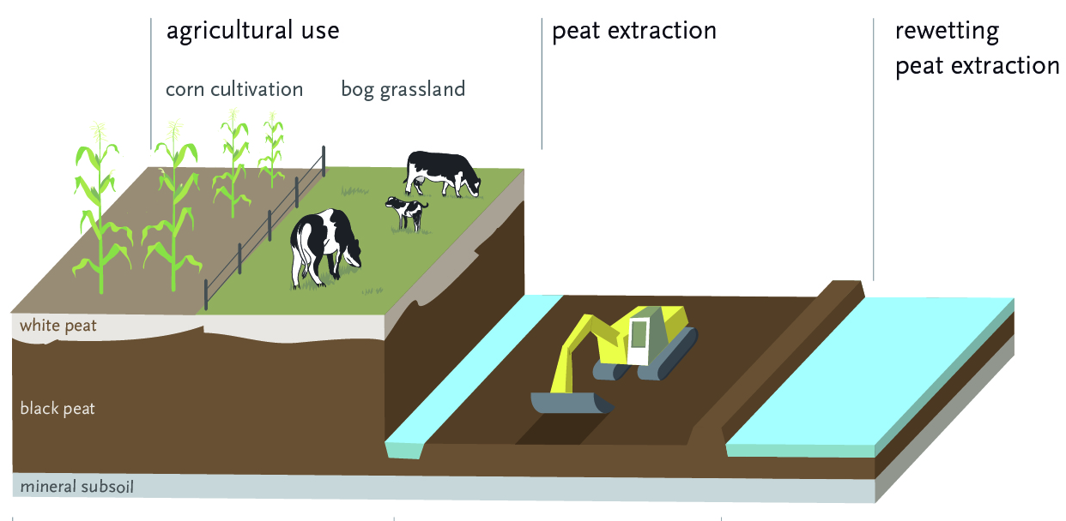
Area: Current bog utilisation types in NW Germany
20.000 ha 92.000 ha 11.000ha
Notes:
usage categories of drained raised bog areas: Grassland 92.000 ha, bush/heather/peatland 54.000 ha Acker auf Hochmoor (arable land) 20.000 ha forest 13.000 ha others (e.g. peat extraction 11.000ha ) 29.000ha based on Atkis basis DLM 2015 (niedersächsische Moorlandschaften) vgl. Natura 2000 50.800ha

Slide 11
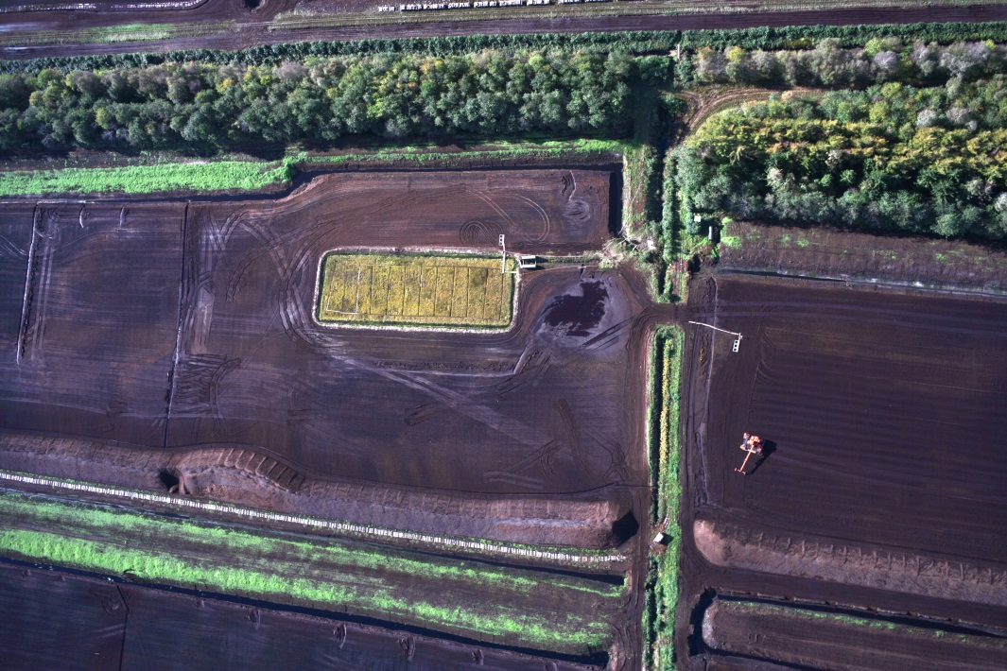
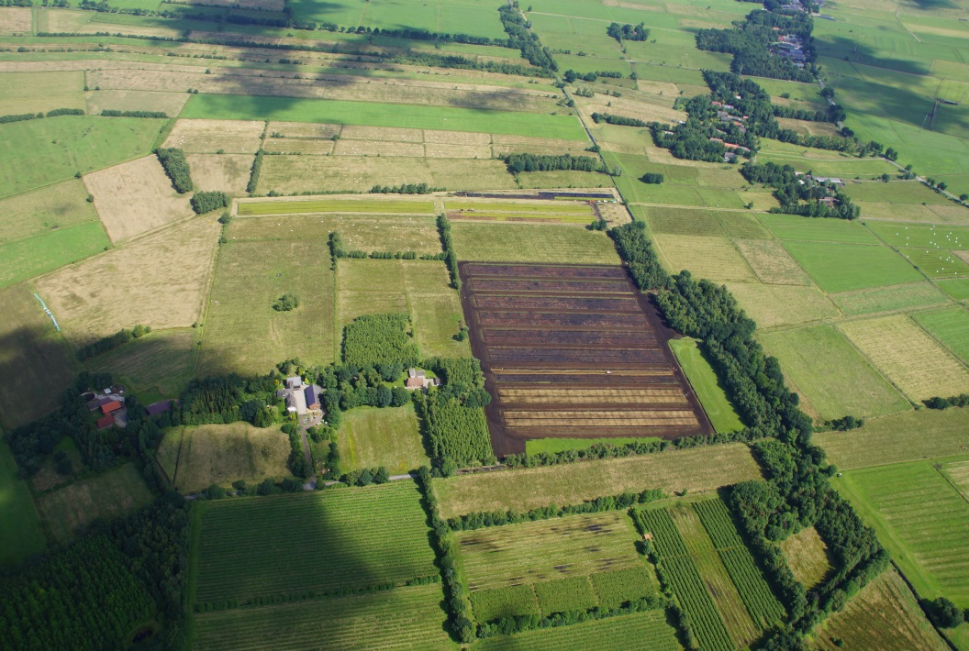
Activities: Enlarging the area
Foto: MoKuRa
Foto: MoKuRa
Ca. 1100 Squaremeter 13 Hectar
on cut-over bog on former bog grassland

Slide 12
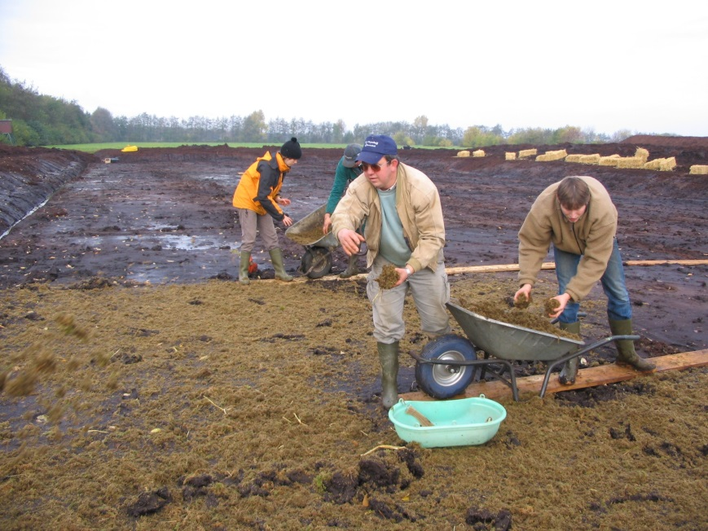
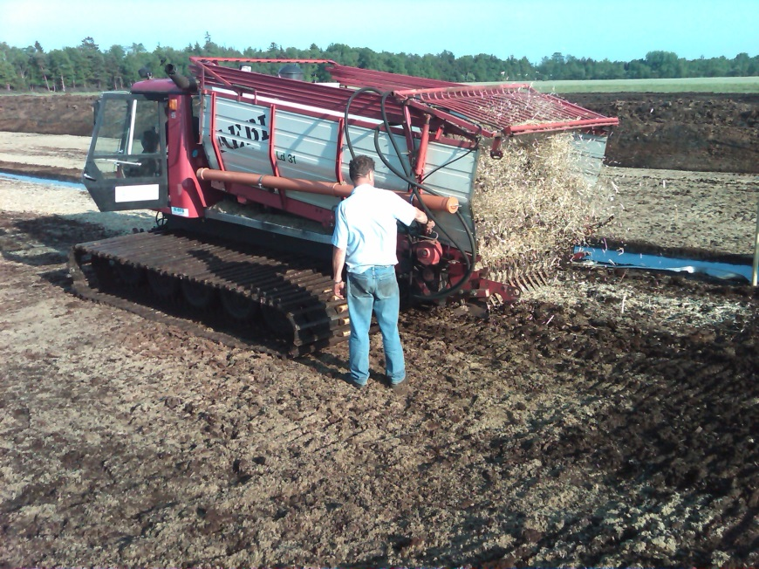
Activities: Spreading of Propagation material
Foto: MoKuRa
Foto: MoKuRa
Manually
with adepted machinery

Slide 13
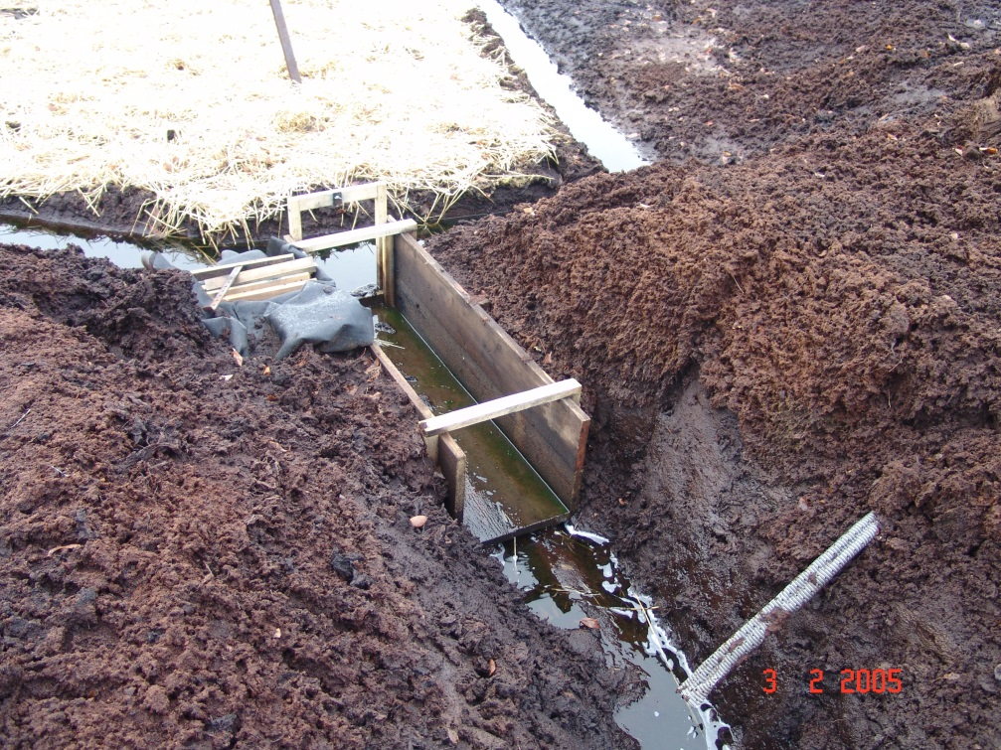
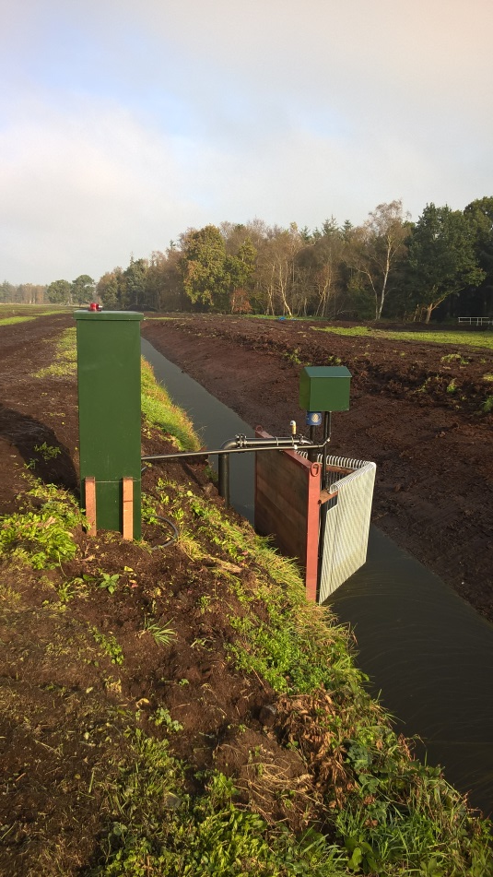
Activities: Water supply
Foto: MoKuRa
Impoundment in ditches and drainage pipes with a small dam, water pump winddriven
Foto: MoKuRa
Electric pumps with automatic regulation

Slide 14
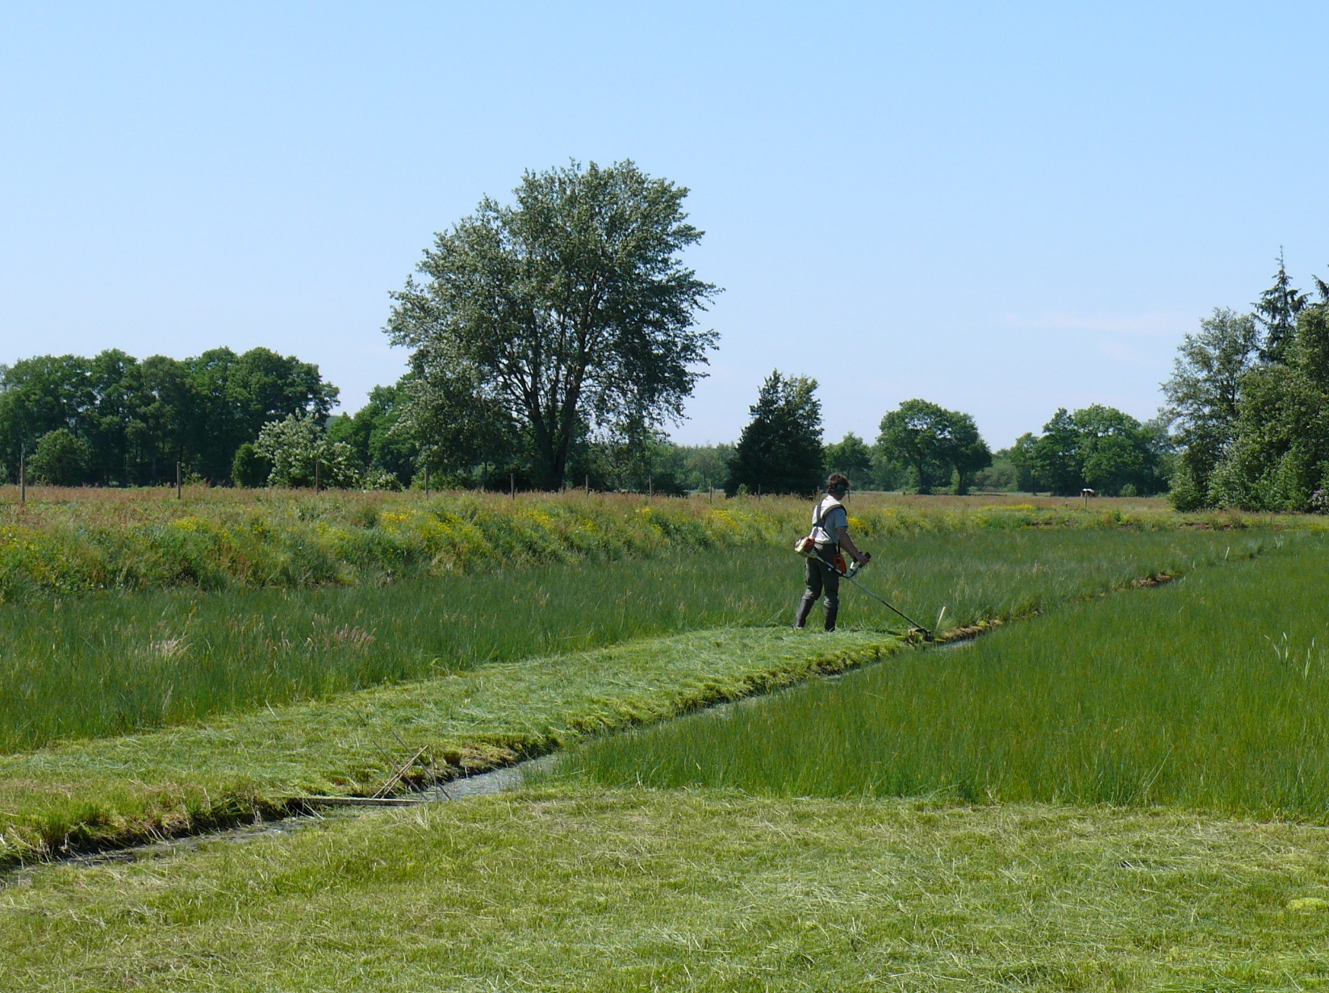
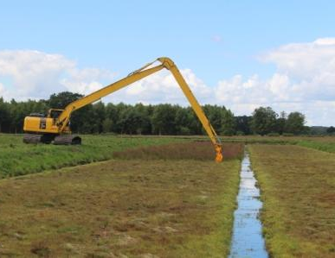
Activities: Management of vascular plants
Foto: Uni Greifswald
Foto: Uni Greifswald
String trimmer
Excavator with mowing masket
Notes:
sling trimmer? brush cutter?

Slide 15
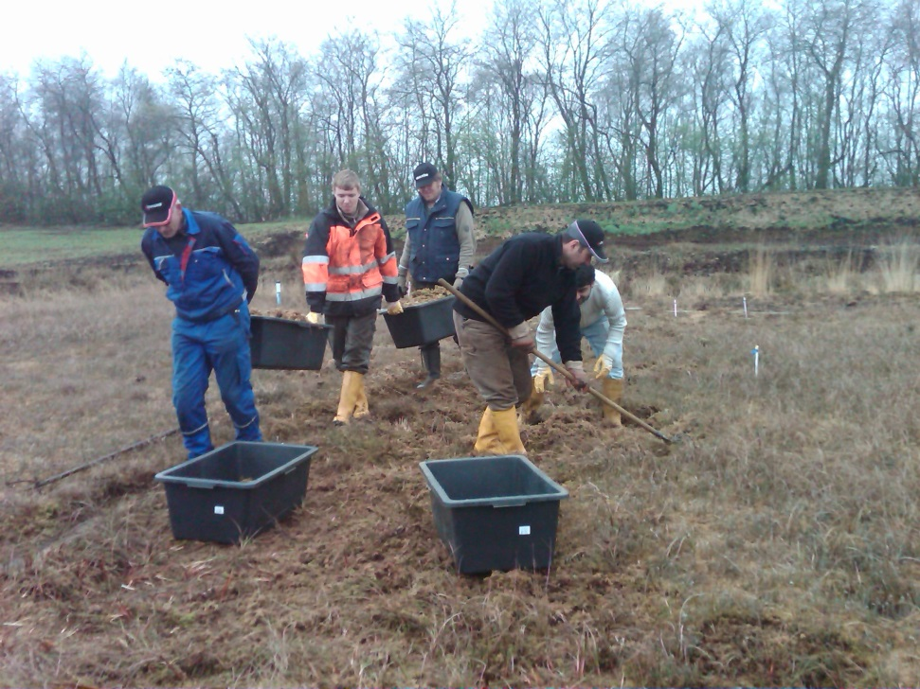
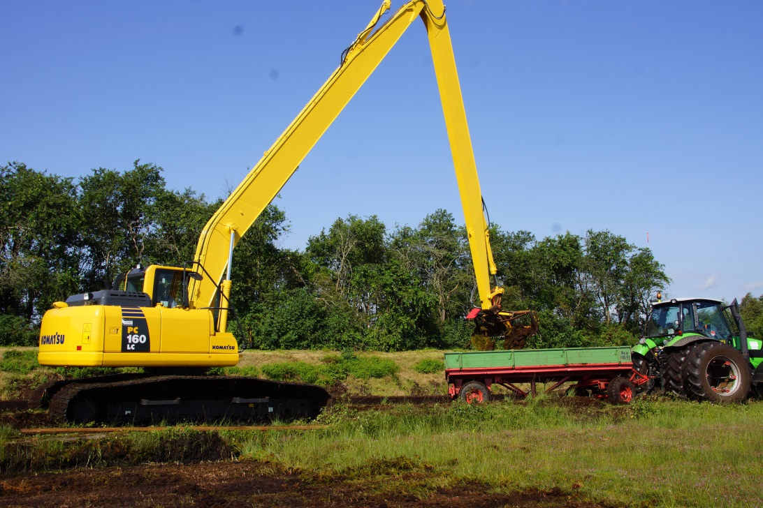
Activities: Harvesting
Foto: MoKuRa
Foto: MoKuRa
Manually
Excavator with mowing basket

Slide 16
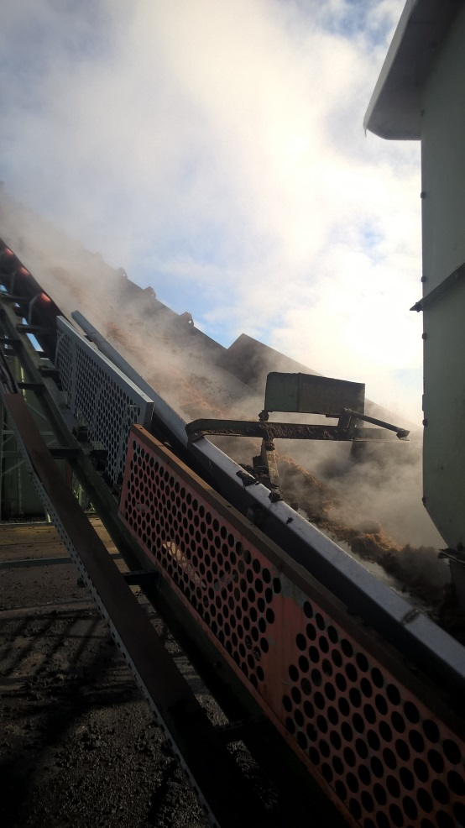
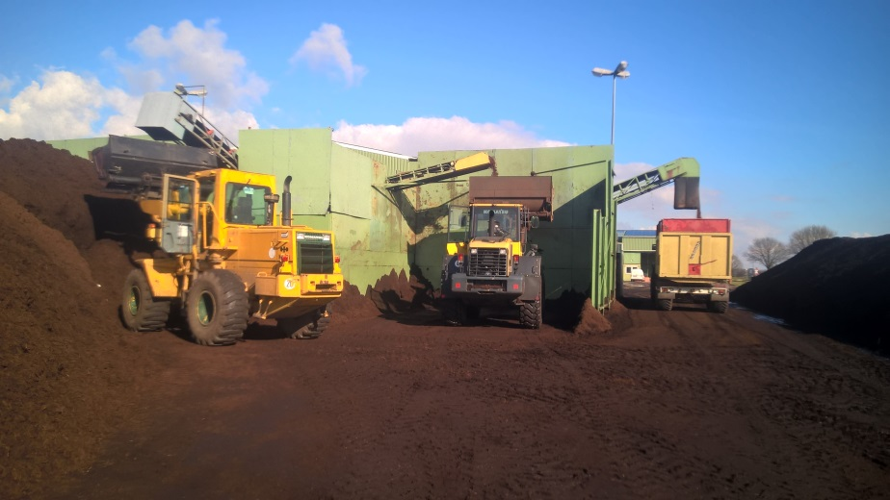
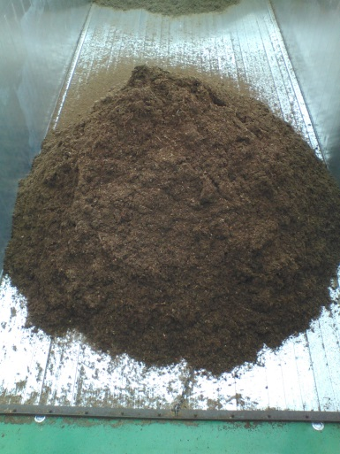
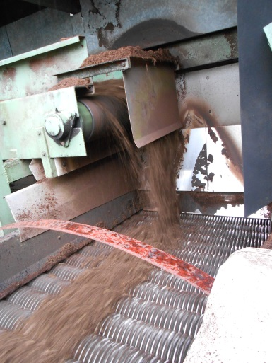
Activities: Conditioning of Sphagnum for GM
Heat treatment
Screening
Foto: MoKuRa
Foto: MoKuRa
Foto: MoKuRa
Foto: MoKuRa

Slide 17
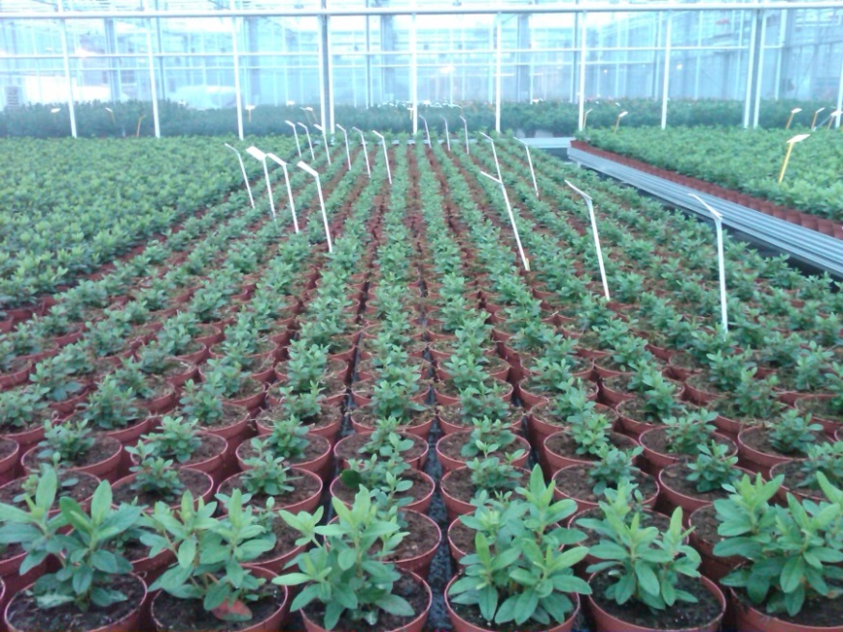
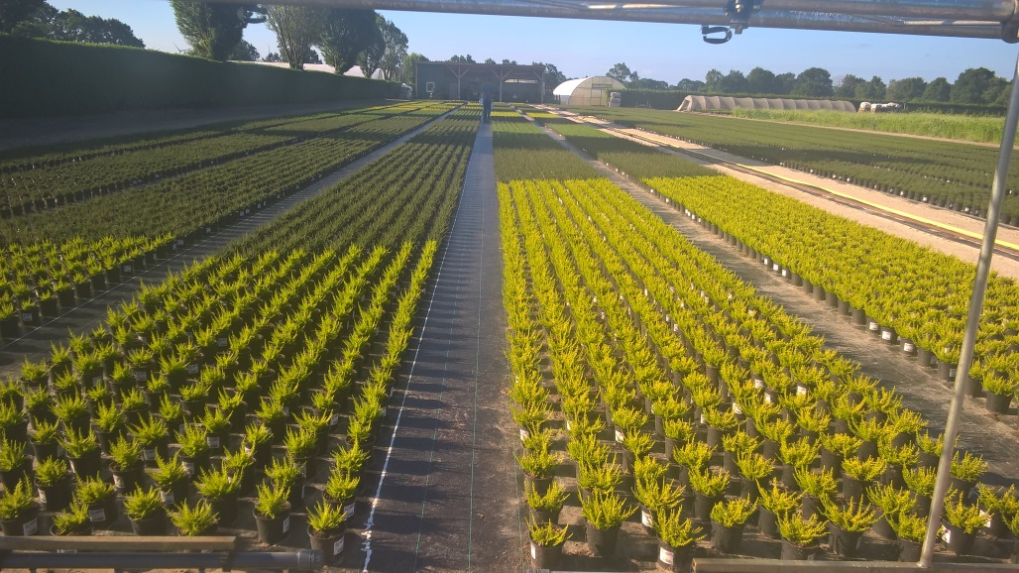
Activities:
Tests of GM with Sphagnum
Research Institution
Azalea, Gaultheria, Rhodendron
Malus, Pyracantha, Lonicera
Horticultural enterprises
Poinsettia
Vegetable seedlings
Calluna
Foto: MoKuRa
Foto: MoKuRa
Notes:
Azalea, Checkerberry or wintergreen or eastern teaberry, Apples, Firethorn, box honeysuckle Winter rose, Heather or ling

Slide 18
Mosaic of different Sphagnum farming types
on degraded bogs
2004-2014
Notes:
neu

Slide 19
study site cut-over bog: schematic view
a)
N
20 m
cross section
piling
inlet
outlet
b)
irrigation pipe
ditch
white peat
Sphagnum lawn
black peat
mineral subsoil
5 m
Size: ca. 60x20 m
Irrigation: pipes every 5 m and surrounding ditch
On black peat (H7), ca. 1.8 m thick
Gaudig et al. 2017

Slide 20
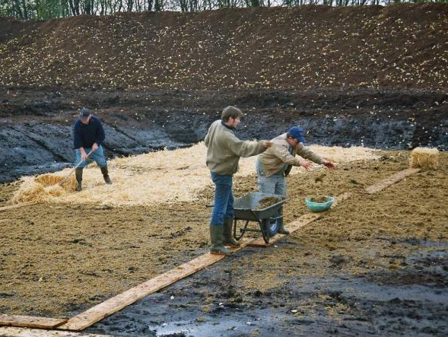
November 2004
study site cut-over bog: spreading of mosses and straw
  Sphagnum papillosum
  fragment length 0.5-2 cm
  initial cover ~95% (brownish mosses)
Foto: D. Kamermann
Notes:
20

Slide 21
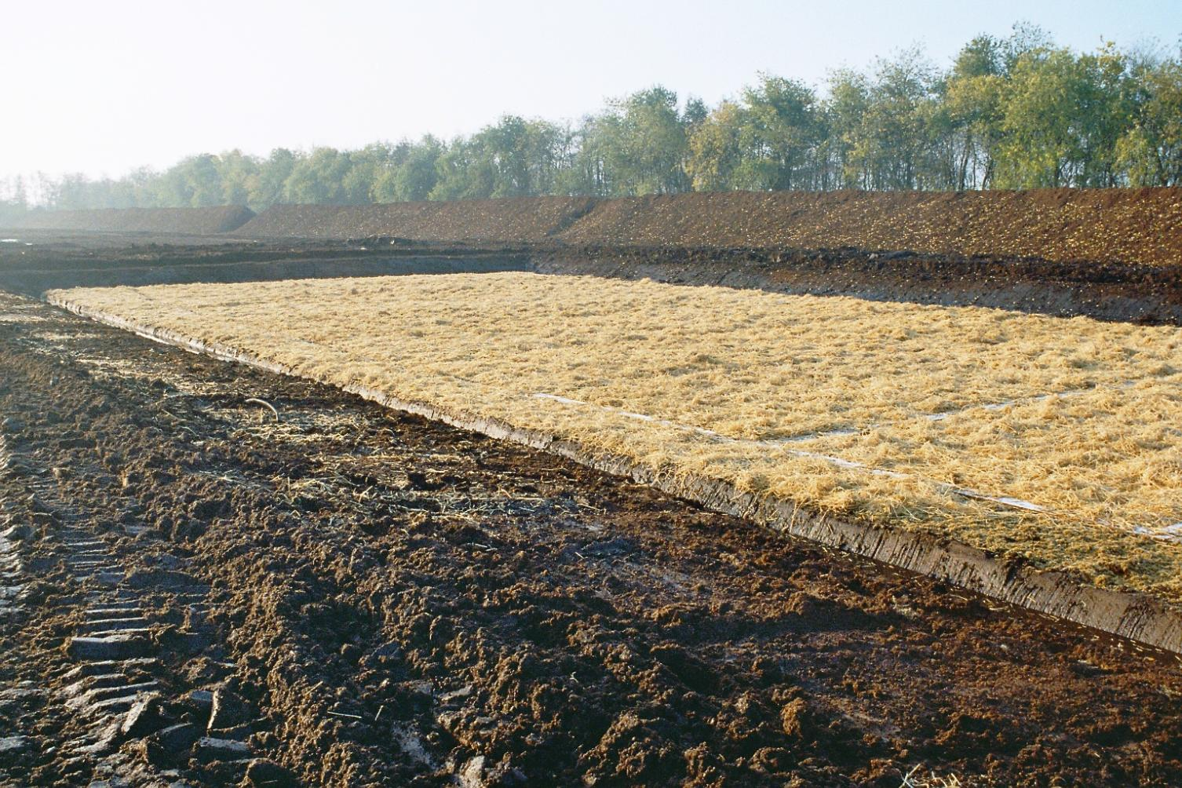
study site cut-over bog: after installation
Nov 2004
Foto: D. Kamermann

Slide 22
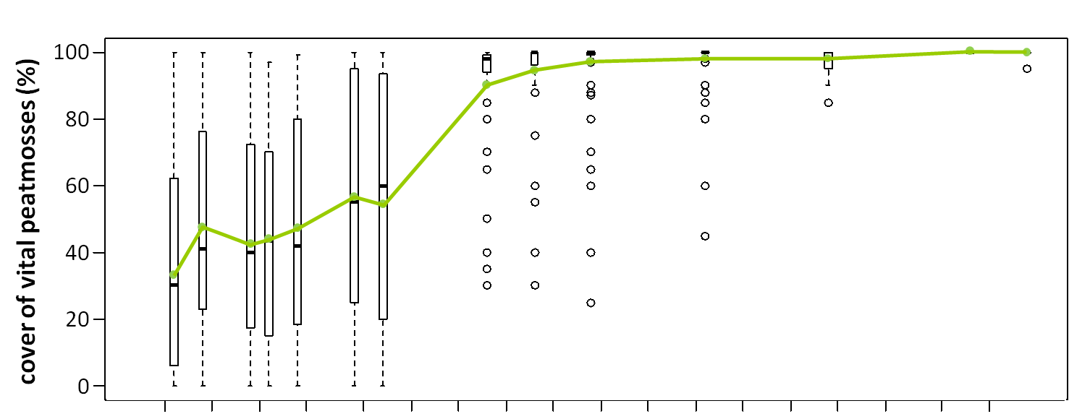
Sphagnum papillosum cover
establishment
growth
1
2
3
4
5
6
7
8
9
years after installation
Continuous increase of vital (green) Sphagnum papillosum cover
Established after 45 months (3.75 years)
Gaudig et al. 2017

Slide 23
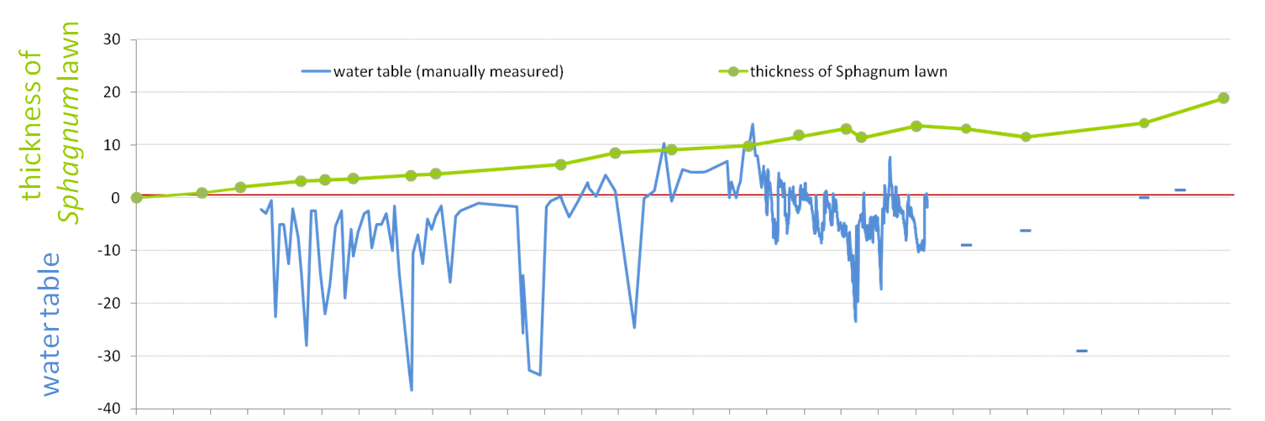
S. papillosum lawn thickness and water table
cm
0
1
2
3
4
5
6
7
8
9
years after installation
Continuous growth of Sphagnum papillosum lawn
Up to 19 cm (mean) after 10 years
Stagnation period = dry conditions
Gaudig et al. 2017

Slide 24
Mosaic of different Sphagnum farming types
on degraded bogs
since 2010
Notes:
neu

Slide 25
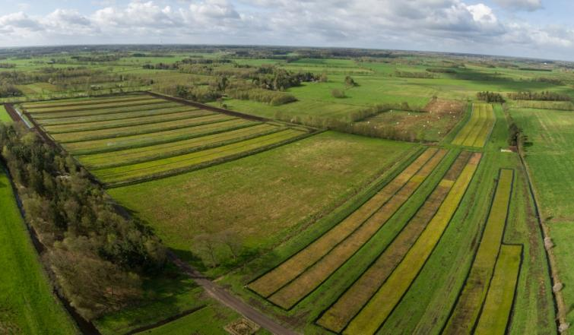
study site bog grassland: 13 ha
April 2017
© Tobias Dahms/ Stephan Busse

Slide 26
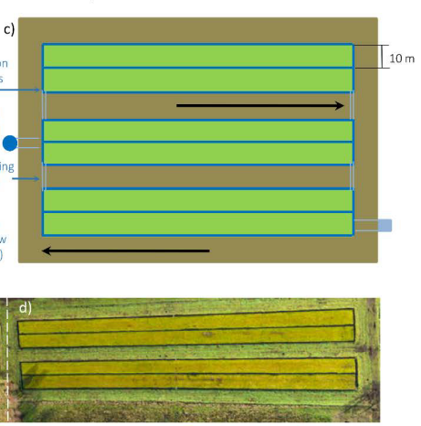
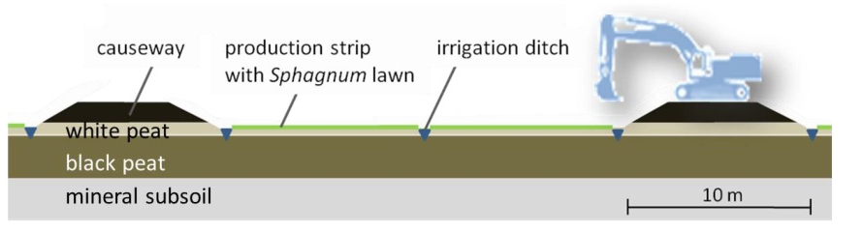
aerial view
schematic view
Irrigation: ditches every10 m
On white peat (H3-6)
inlet
outlet
causeway
irrigation
ditch
Sphagnum lawn

Slide 27
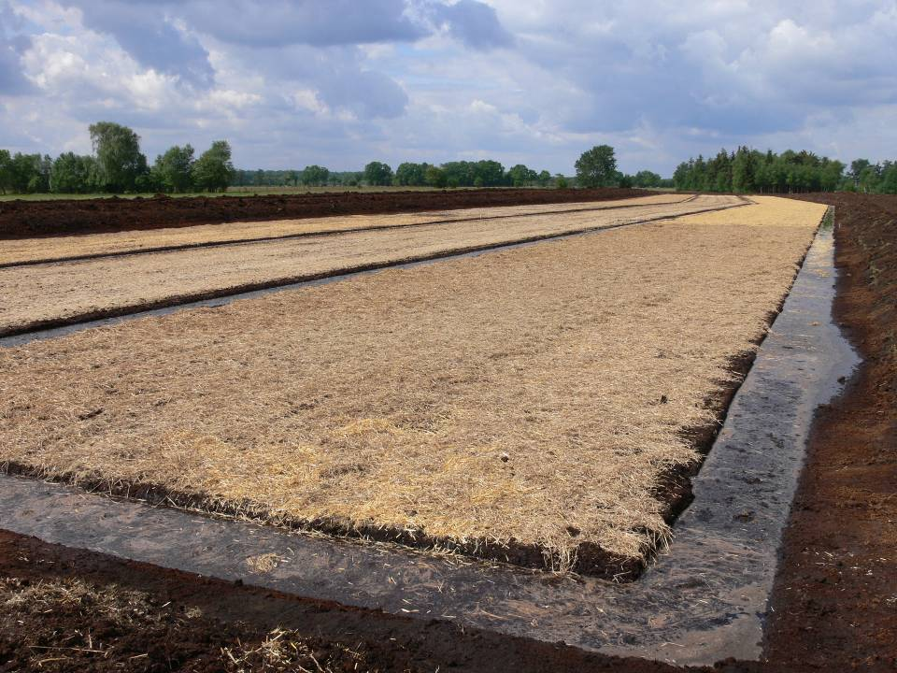
study site bog grassland: after installation
June 2011
Foto: Uni Greifswald
Notes:
Neues Bild

Slide 28
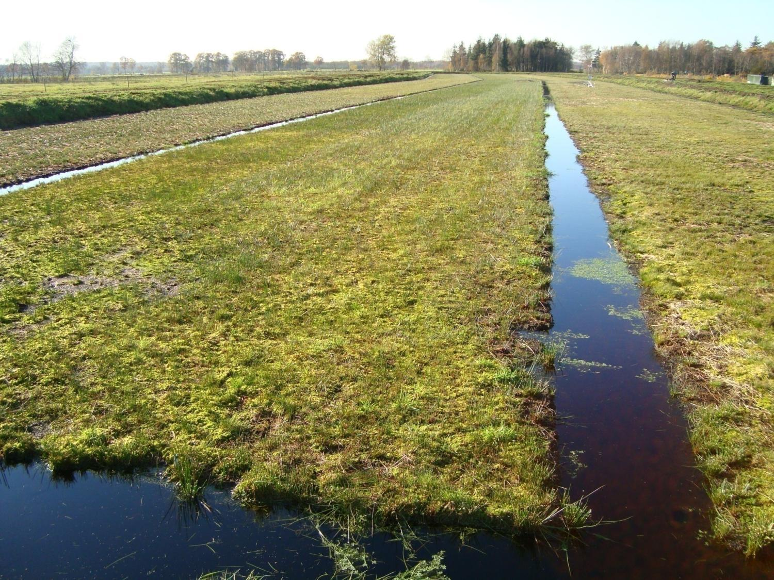
study site bog grassland: ½ year after installation
Nov 2011
Foto: Uni Greifswald

Slide 29
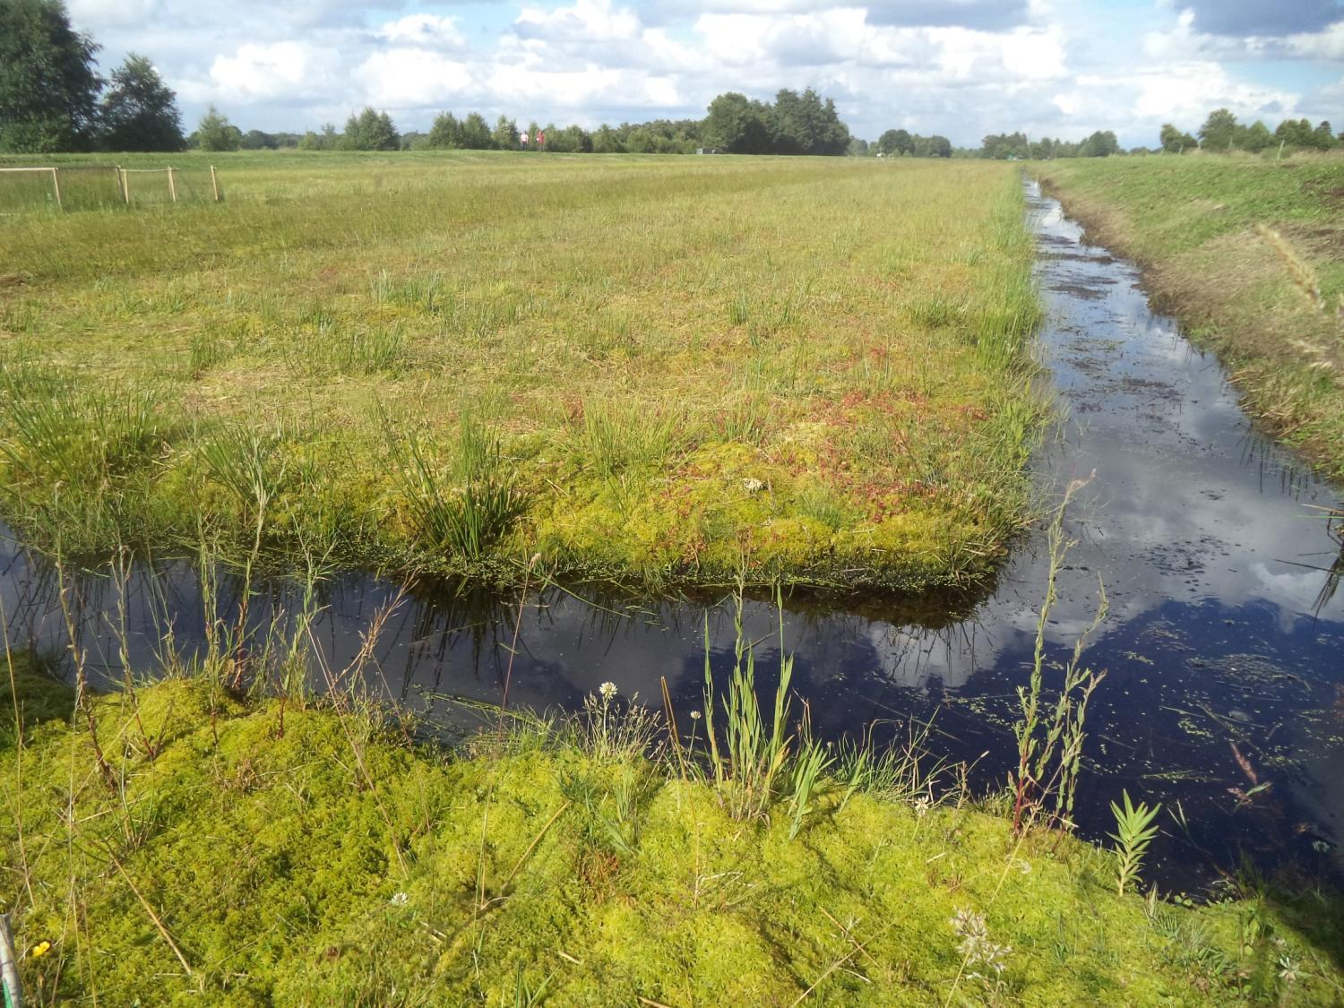
study site bog grassland: 3 years after installation
Foto: Uni Greifswald

Slide 30
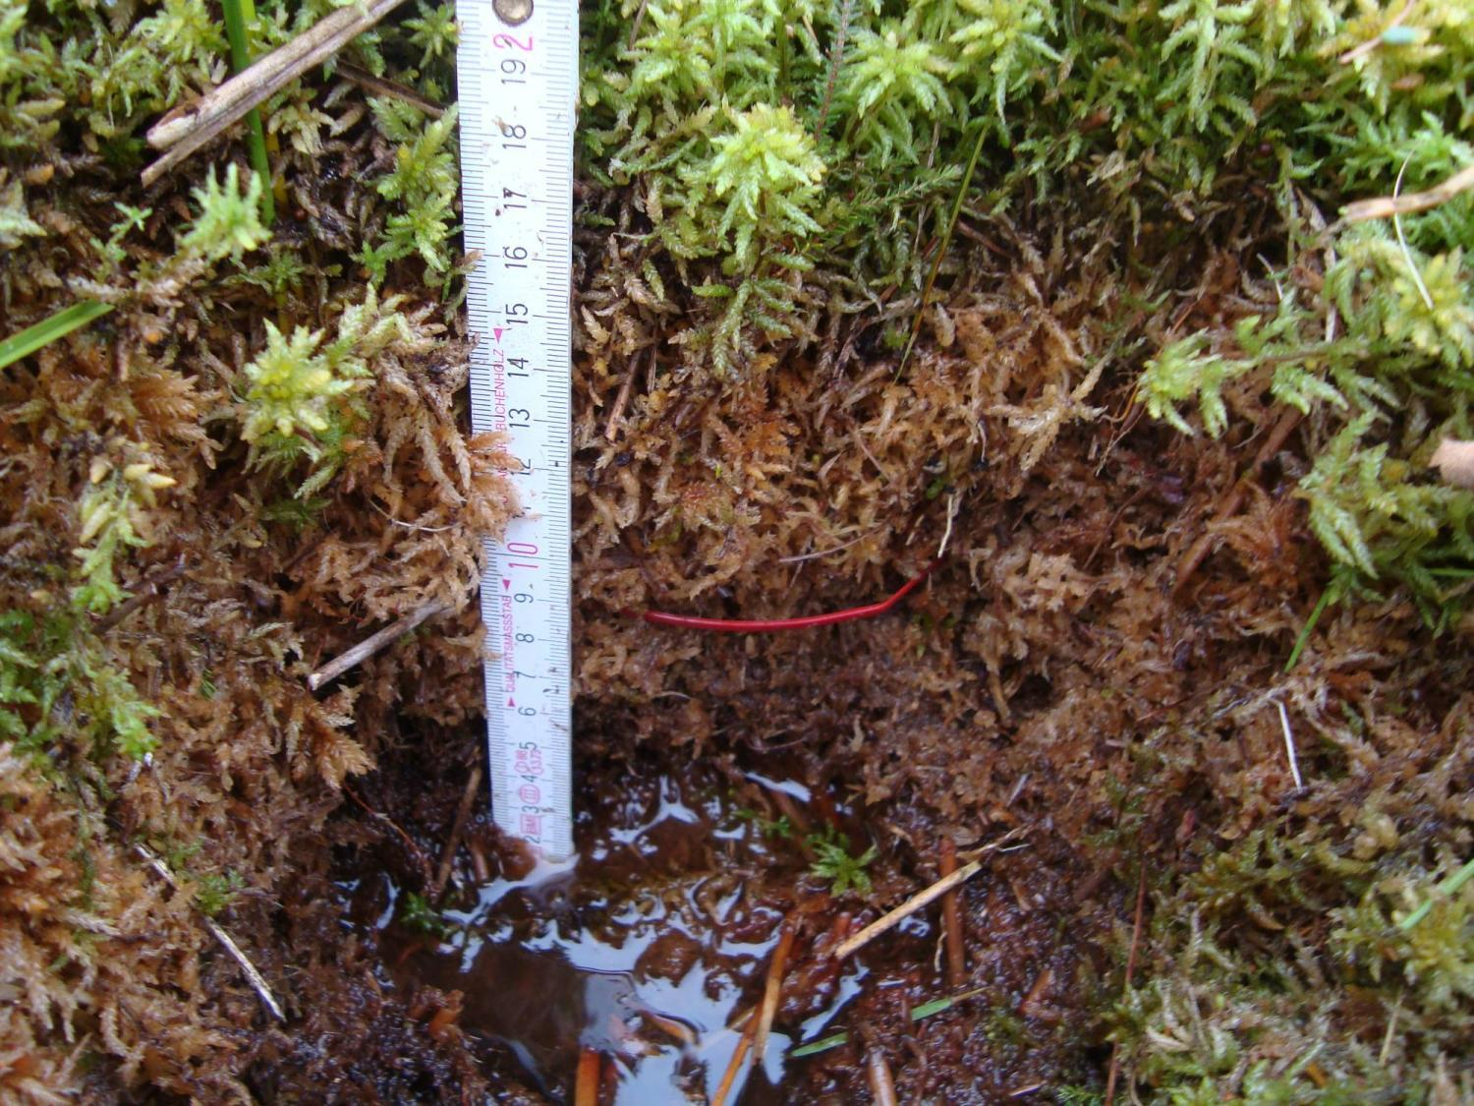
the success:
established lawn after 1.5 years
biomass productivity: ~8.7 t DM/ ha*yr
harvest possible after 3 years
© Uni Greifswald
Foto: Uni Greifswald

Slide 31
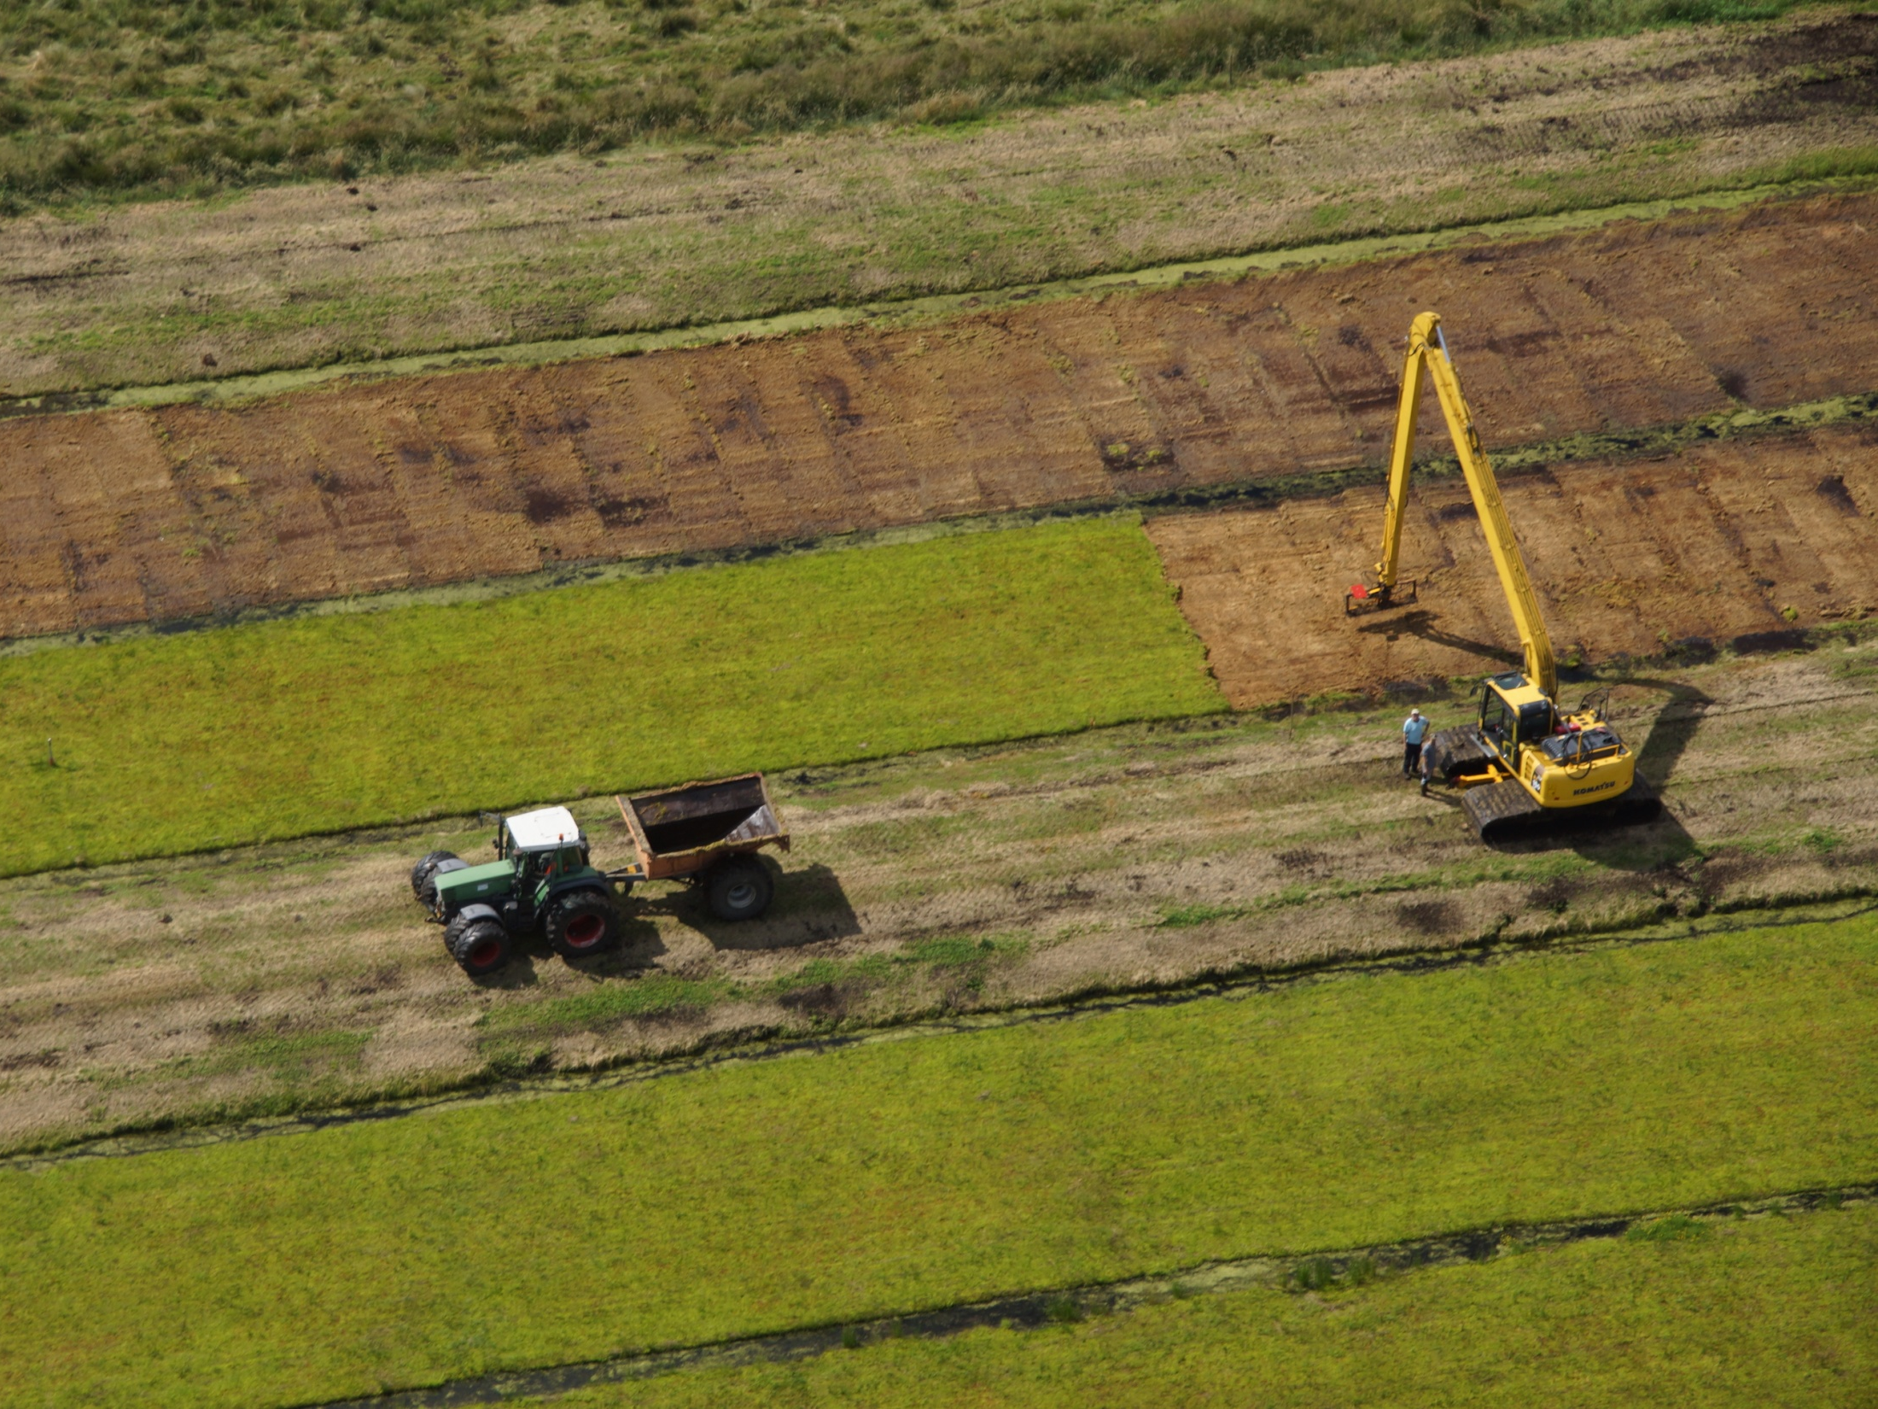
Advantages of Sphagnum farming
  production of a renewable resource
  regional economic benefits
Foto: G. Block, MOKURA

Slide 32
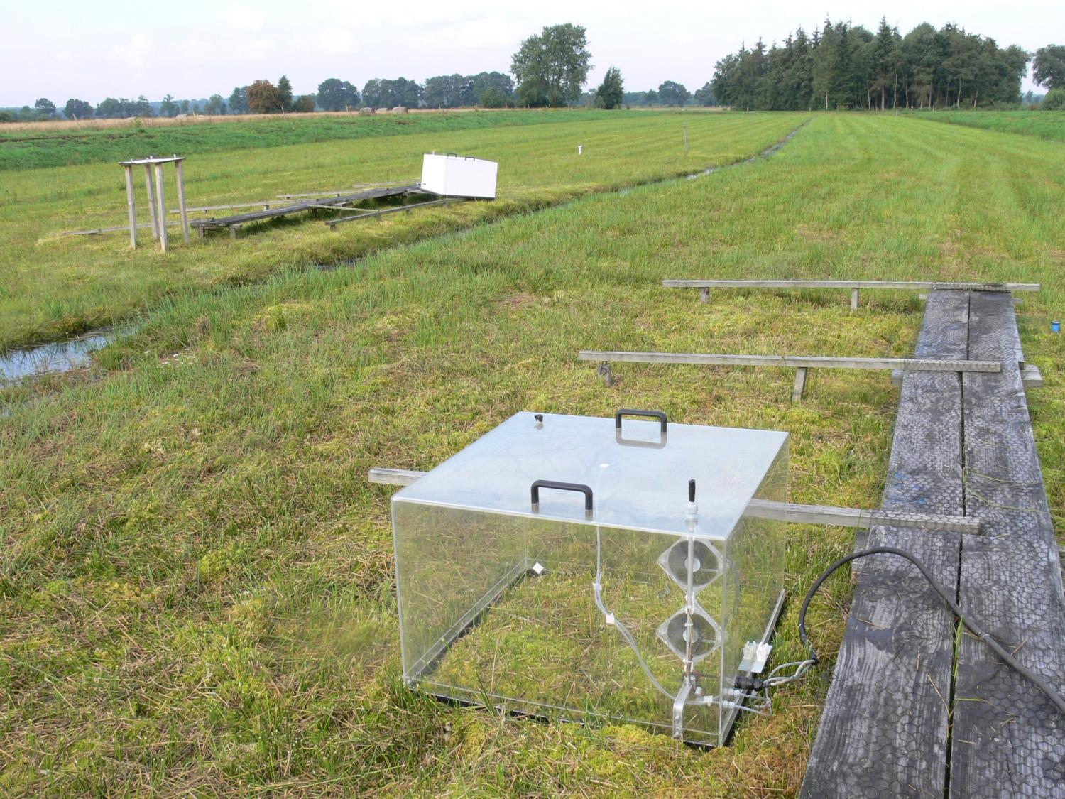
Advantages of Sphagnum farming
  reduction of GHG emissions: ~15 t CO₂- eq. ha⁻¹ yr⁻¹
  stop of subsidence
Günther et al. 2017
Foto: Uni Greifswald
Notes:
Plus Ersatz von fossilem Torf → ca 18 t

Slide 33
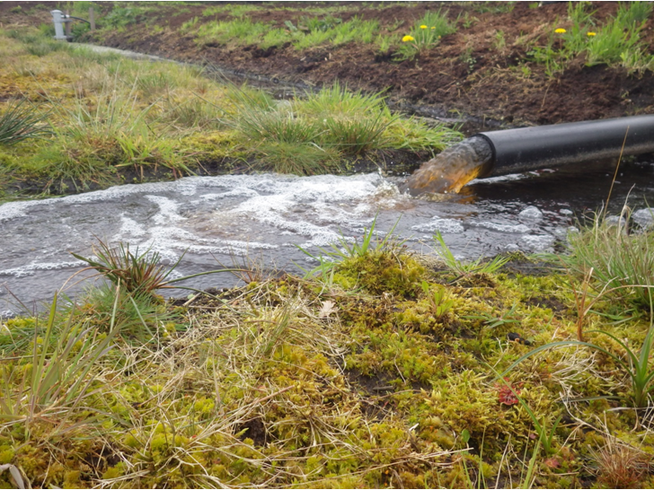
Advantages of Sphagnum farming
  improvement of hydrology and regional climate
  decrease nutrient loads in surface waters: 64 kg N + 7 kg P ha⁻¹ yr⁻¹
Temmink et al. 2017
Foto: Uni Greifswald

Slide 34
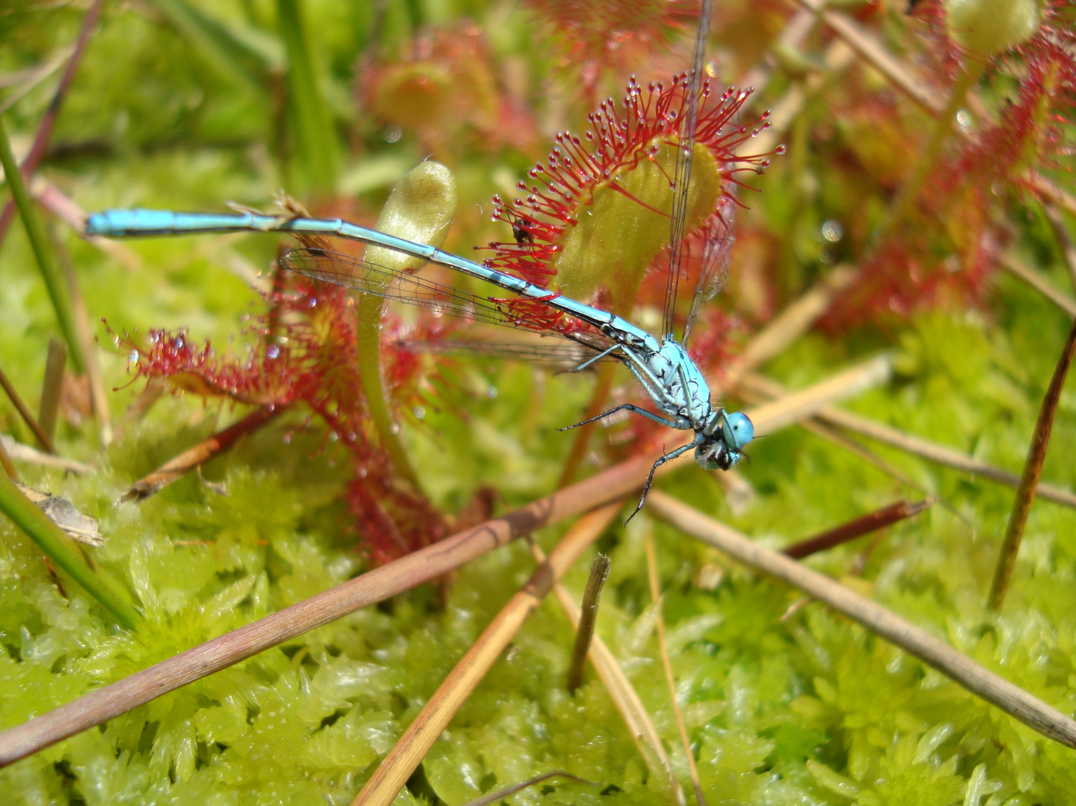
Advantages of Sphagnum farming
  habitats for endangered peatland species
Muster et al. 2015
Foto: Uni Greifswald

Slide 35
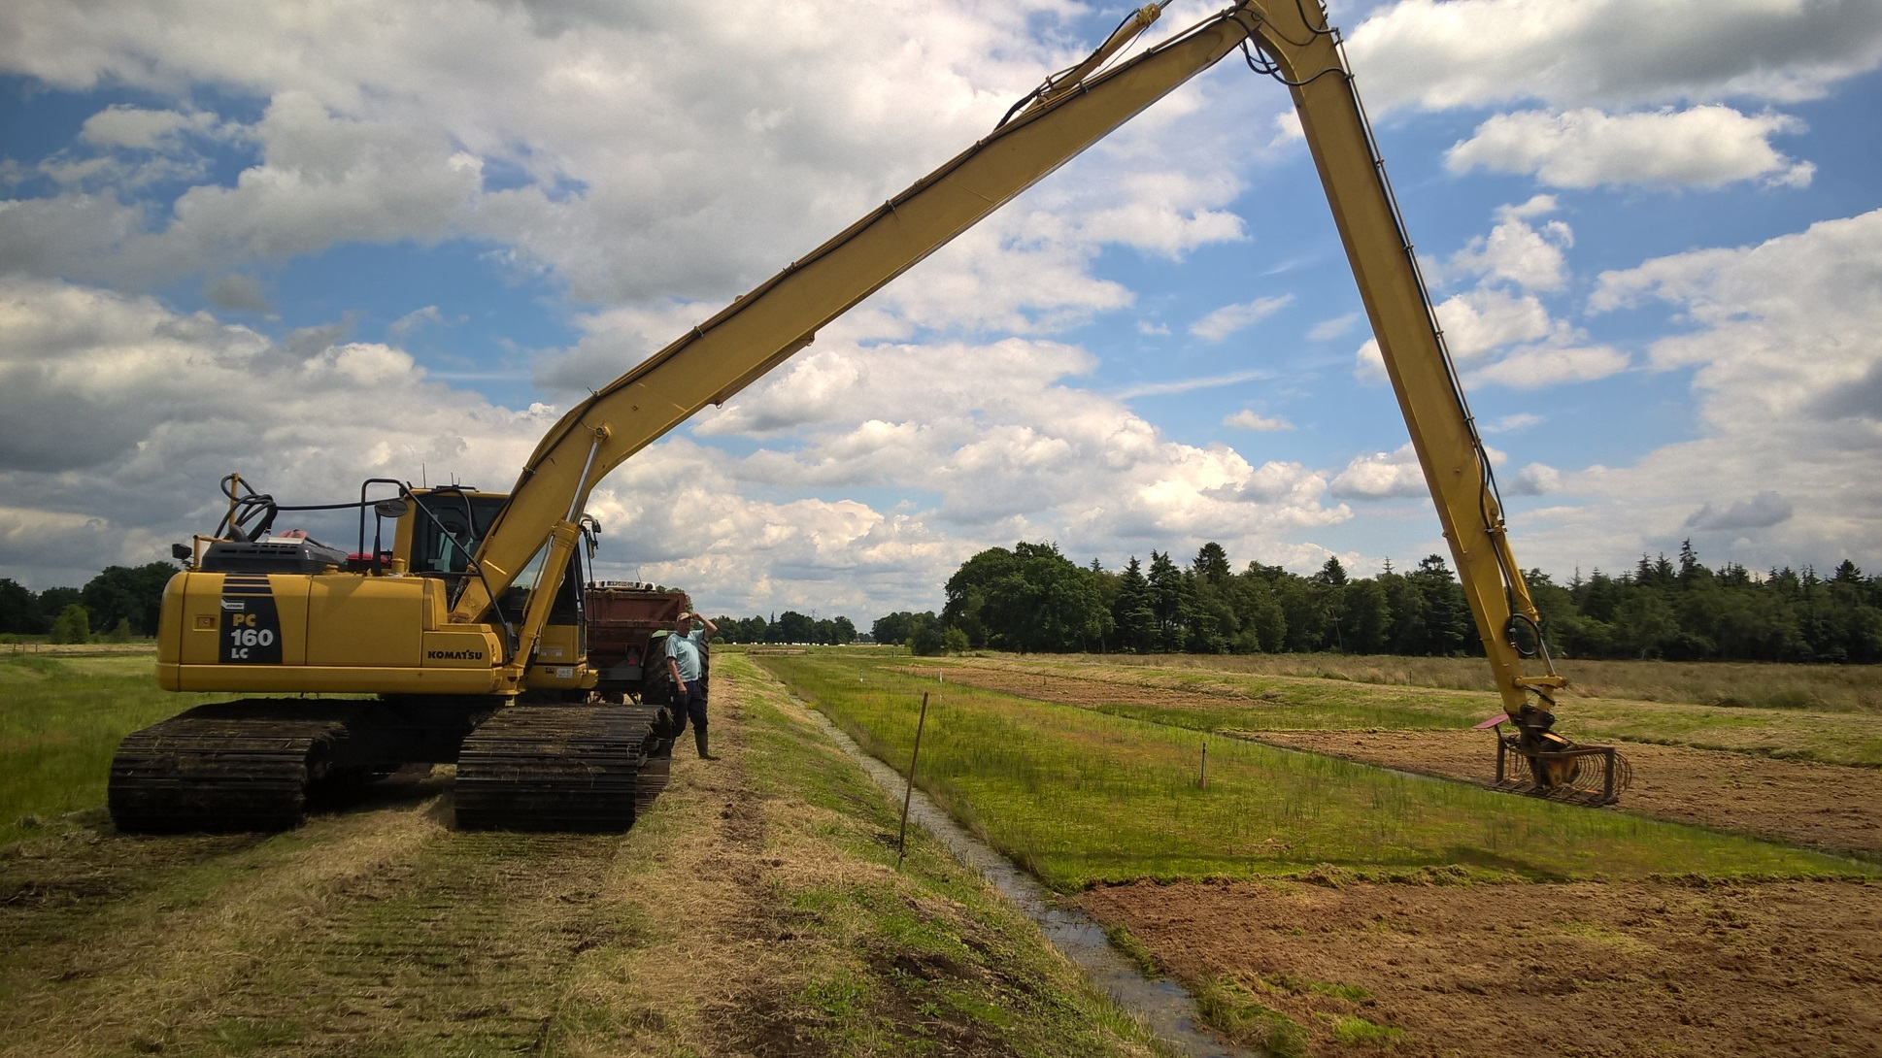
Thanks for your attention!
Questions???

